Slide 1
Building Learning and Caring Communities through High-Quality Lesson Studies
WALS 2012
Keynote Address
Singapore
Kiyomi Akita, Ph.D.
Professor, Graduate School of Education
The University of Tokyo, Japan
Notes:
Ladies and Gentleman, It is my honor to talk about Japanese LS .
My presentation today is “Building Learning and Caring Communities through High-Quality Lesson Studies”.

Slide 2
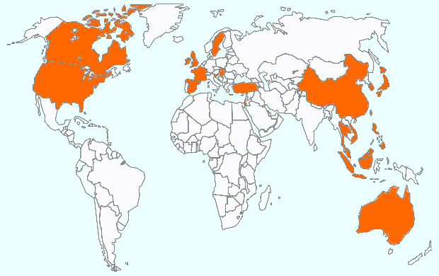
Spread of LS Through WALS: 24 countries(Lee,2011)+
8 countries (2012)
Sweden
Canada
UK
Slovakia
France
Hungary
Switzerland
Korea
US
Spain
China
Turkey
Japan
Israel
Macau
Hong Kong
Taiwan
Thailand
Vietnam
Philippines
Malaysia
Brunei
Singapore
Indonesia
Australia
Notes:
This is the PPT that our president Chiritine lee introduced last year.. Eight more countries attend this year’s conference. The network of LS has been spreaded.

Slide 3
Quality Matters
Lee, C.(2011) “Crossing Borders: The Global Spread of LS”
Number of countries that engage in LS:
WALS: 25 JICA: 20 APECS: 17 UNESCO: 14
The greater the number of countries, the more important the role of the contributions of international and local networks (conferences and publications).
There are variations of LS, depending upon who introduced LS, how it spread, its definition, and its main elements.
There are common interests beyond these variations. These include the improvement of the quality of lesson studies (sustainable system and scaling up for children’s learning and teachers’ professional development).

Slide 4
Agenda of Presentation
RQ1 What are the characteristics of high-quality lesson studies? What factors are related to quality?
RQ2 How can high-quality lesson study be realized? How do we create and improve upon a school system as a learning and caring community?
RQ3 What are the design principles of high-quality lesson studies?

Slide 5
Research Question #1
What are the characteristics of high-quality lesson studies? What factors are related to quality?

Slide 6
Two Educational Reform Models (Akita,2011)
Single-goal
standard model
Method-oriented
PDCA cycle for Single-goal
Management/Control/
Check and improve
Single ideal model of reform
General theory into practice
Top-down
Behavioral science-oriented
Democratic
excellence model
Democratic practice
Dialogue and participation
based on autonomy
Collective decision making
by professionals
Multiple local reforms
Theory in practice(LS)
Theory in action
Glass-roots movement
Human science-oriented

Slide 7
For Innovation in Classroom Instruction
The goals of lesson studies vary, depending on the teacher’s needs, the school’s situation, and national and local educational policy, all of which is embedded in a distinctive socio-cultural context.
The important issue is how teachers persistently and systematically connect the learning and development of all children with innovation in classroom instruction and school reform (Penuel et al., 2011; Penuel & Fishman, 2012).
What are the spirit and key principles of LS for better quality?

Slide 8
Factors related to the Quality of LS
A. Structure
- Time span
- Subject
- Participants
- Support system
B. Process
- Children
- Teacher
- School
- Community
C. Effect
- Planning
- Doing RL &
observation
- Debriefing
- Documentation
Notes:
The First one is LS structure, The second is process .

Slide 9
Structure-related Quality
Time span
Lesson
Literacy, numeracy
Support
system
Grade
Curriculum
LS Cycle
Longer span
Inquiry-based
Subject
School
Financial support
Human support
Tools support
Beyond school
Participant
Subject
Art

Slide 10
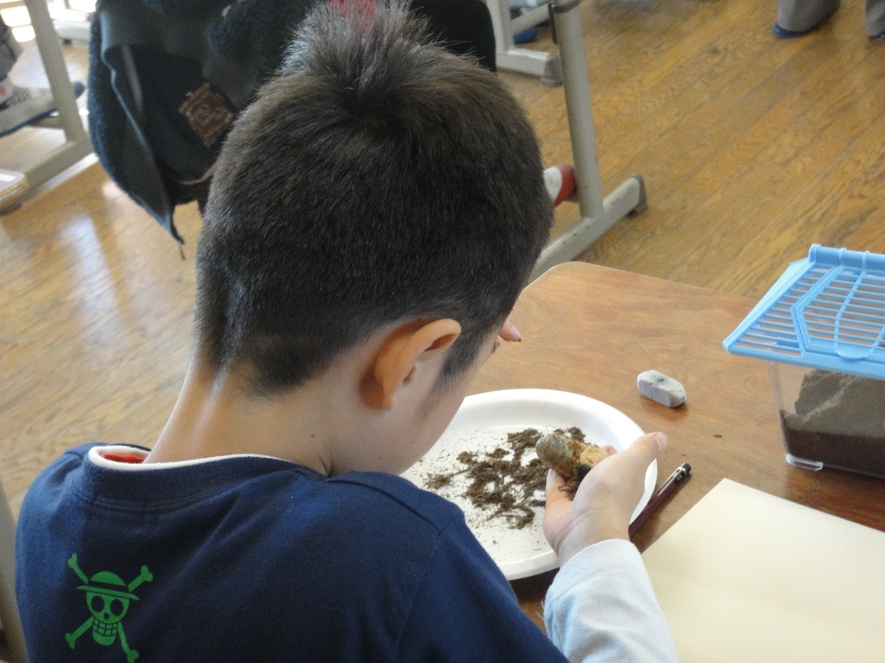
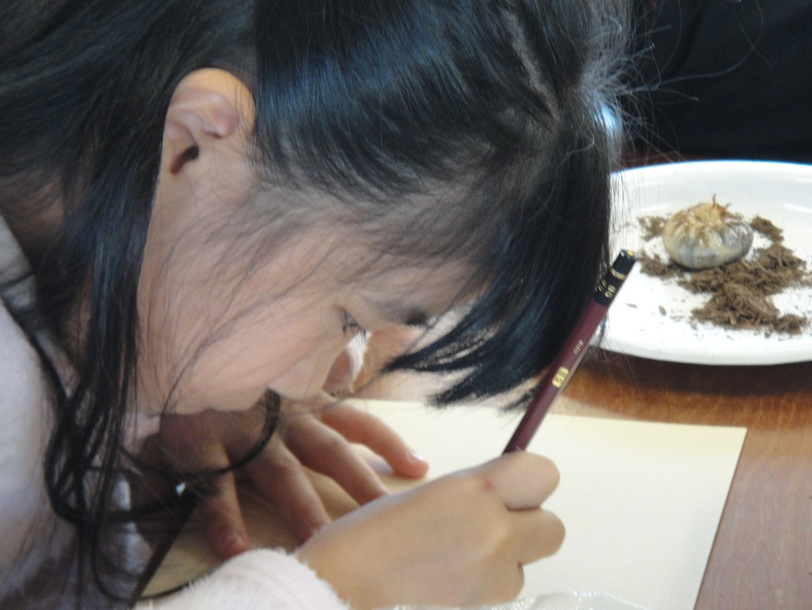
Art Research Lesson
Notes:
These are pictures in art research lesson at 4th grade at the day of annual open school lesson study.
Some children found grub of beetle in the schoolyard. They are interested in the grab of beetle,
So teacher decided the materials children draw. He prepare one grub for every child
The teacher instruct “ Watch attentively, Draw carefully”.
In one hour, Every child watch attentively again and again , touch it softly, and he/she start to draw.
Some children watch for a long time and other children start to draw immideately . Every child draw lines deliberately.at his pace
The climate is so quiet.

Slide 11
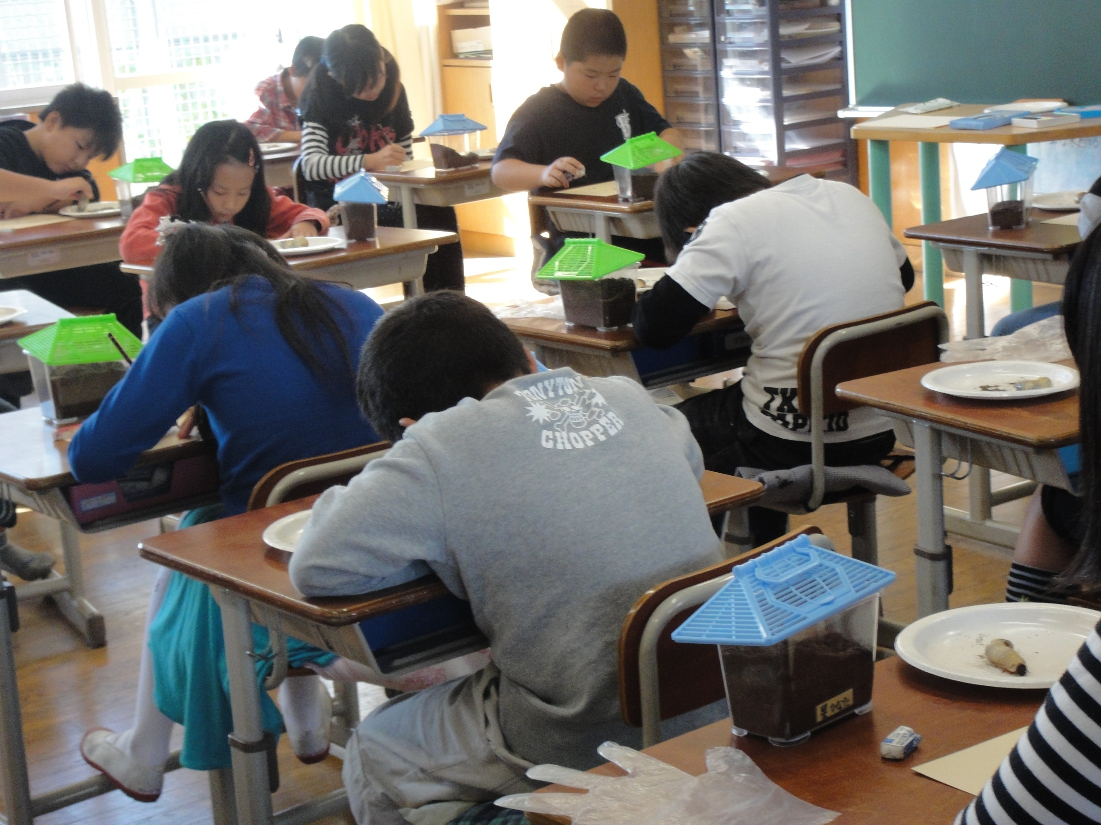

Slide 12
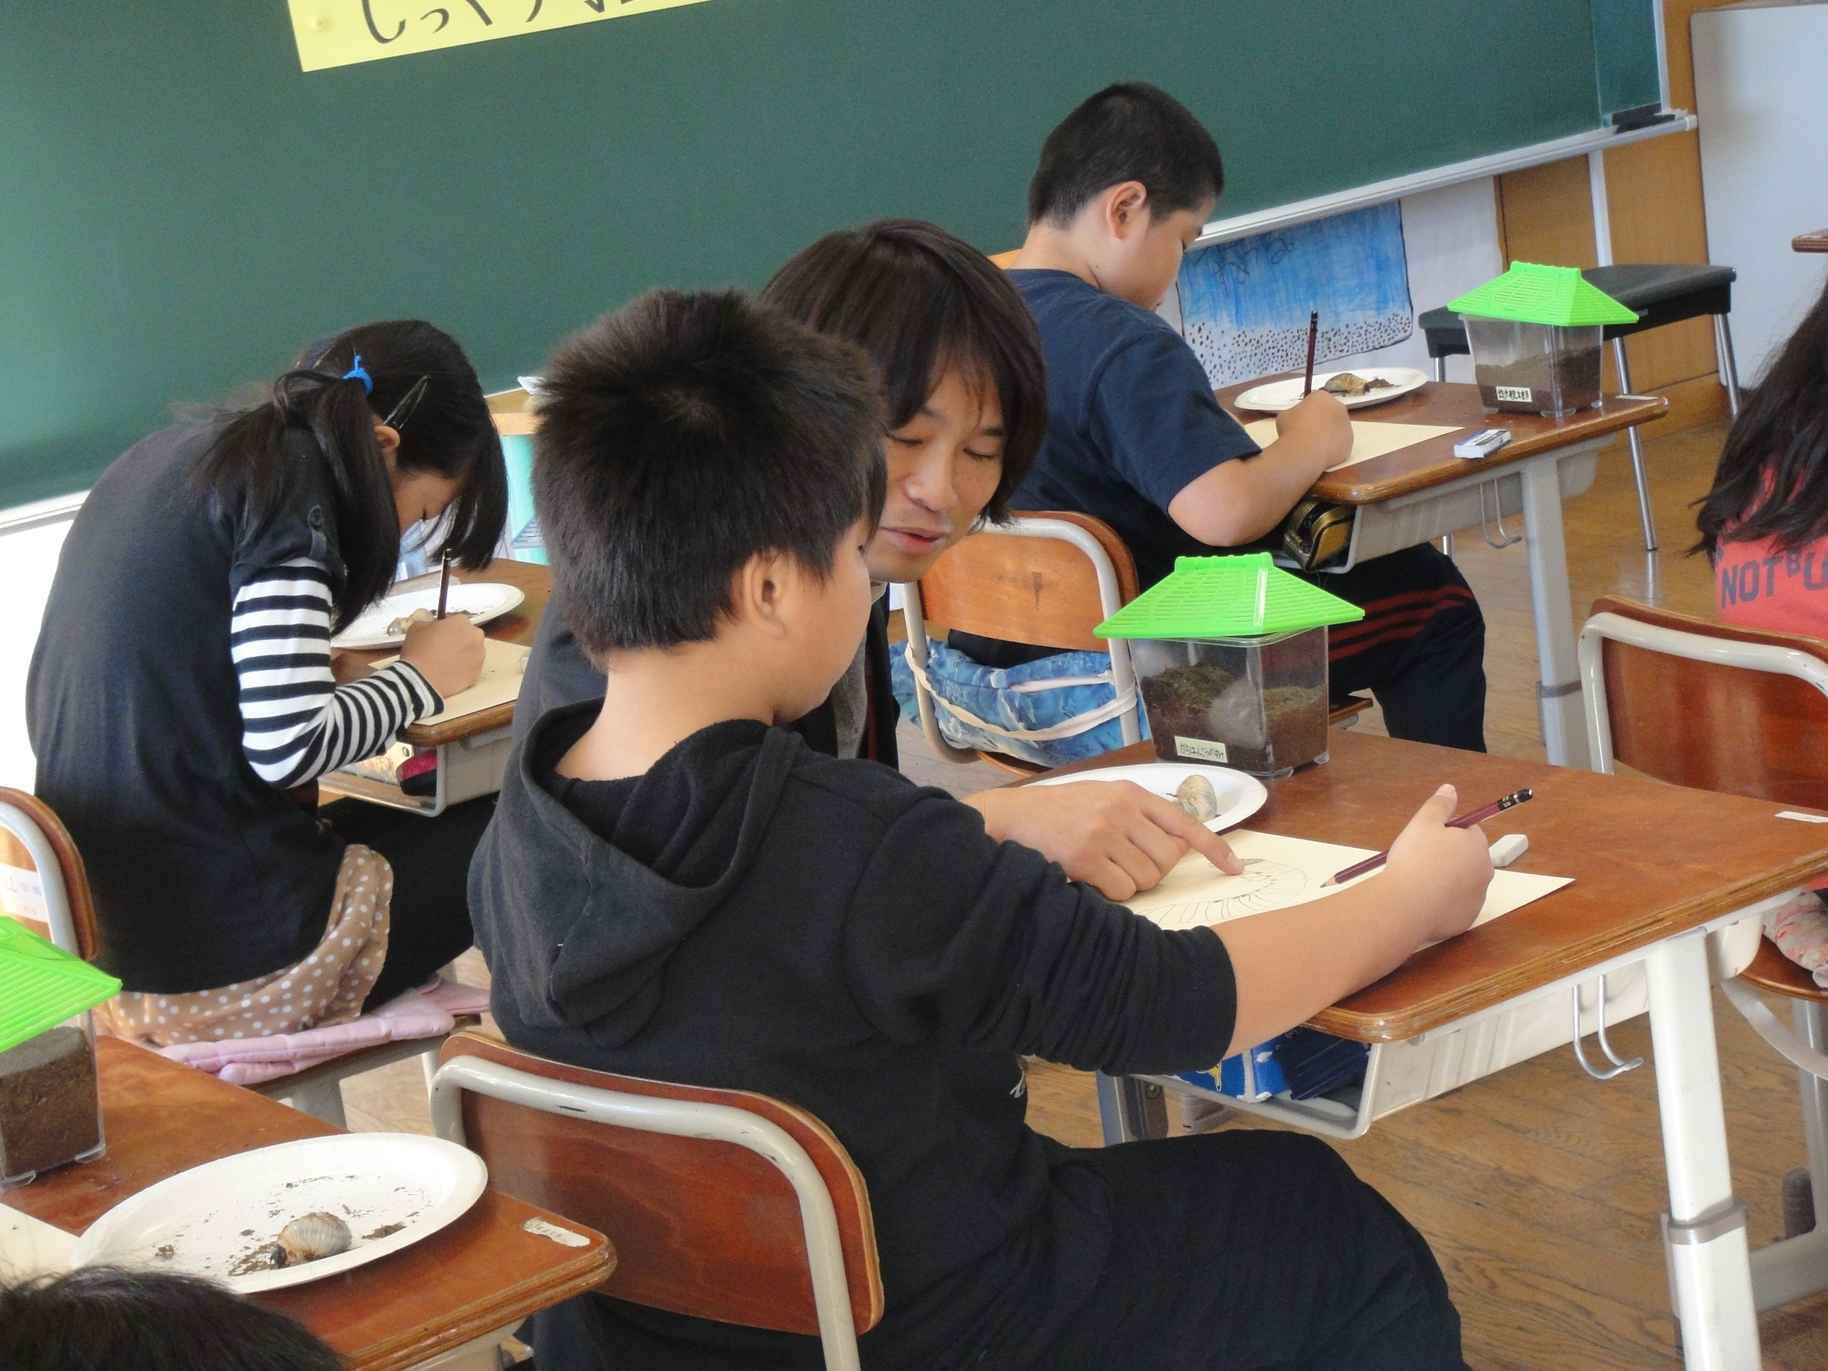
Notes:
The teacher watch children’s drawing carefully and say something to child.
There is so quiet and calm. There is no interaction and teacher do not teach directly.

Slide 13


Slide 14
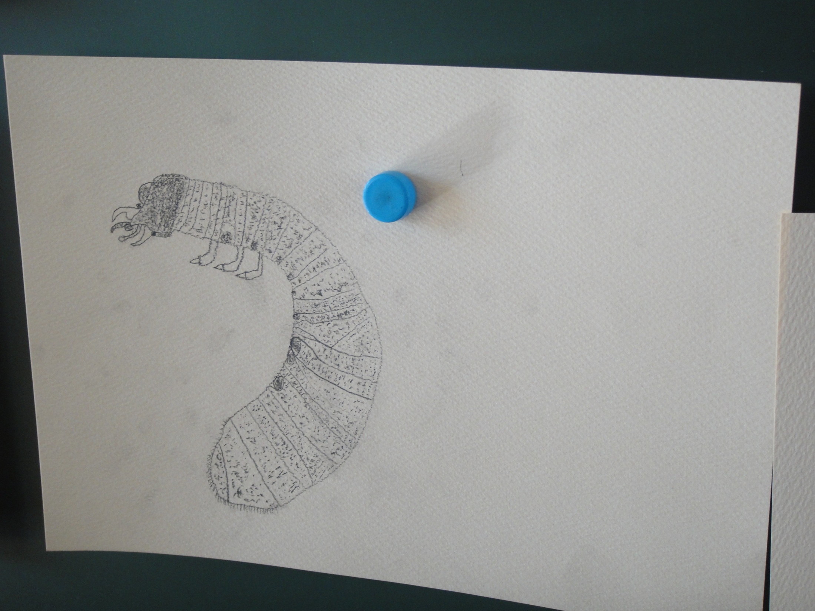

Slide 15
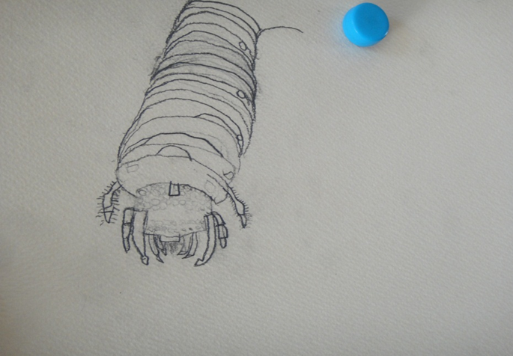

Slide 16
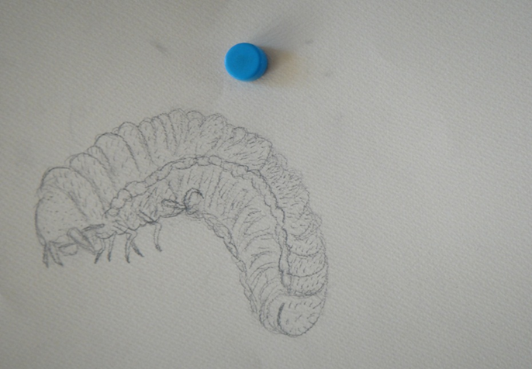

Slide 17
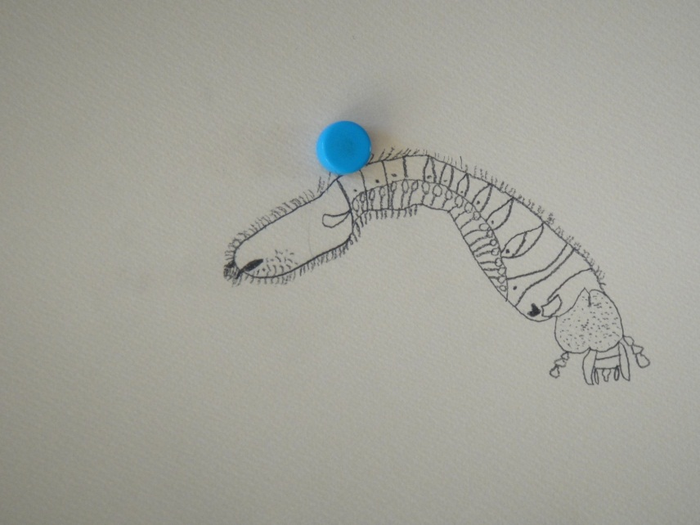
Notes:
But participants observing his lesson learn from many things.
Many teachers have impressed.
After lesson, participants talk with research teacher. The teacher says the children

Slide 18
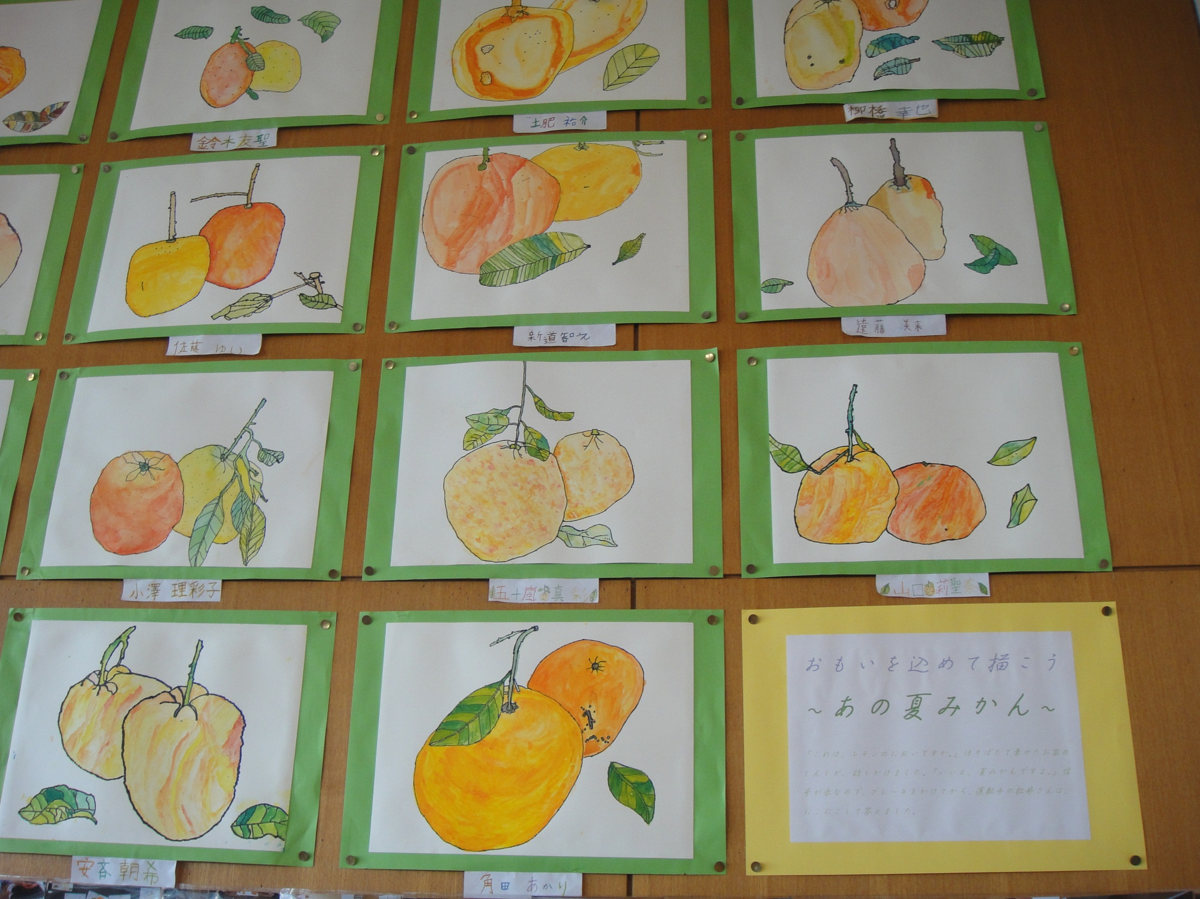
Notes:
In his classroom, the pictures children draw be put on the wall.

Slide 19
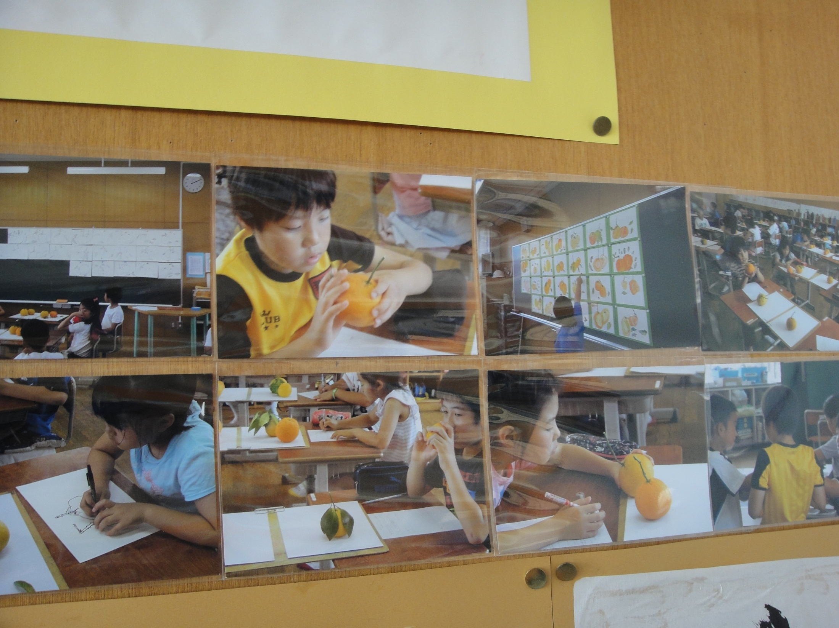
Notes:
And also there are photoes during these activities So children can reflect on their process and remember the ;lesson wel.l.
What is the quality of lesson? What is the work of teachers? Teaching is not telling.
.

Slide 20
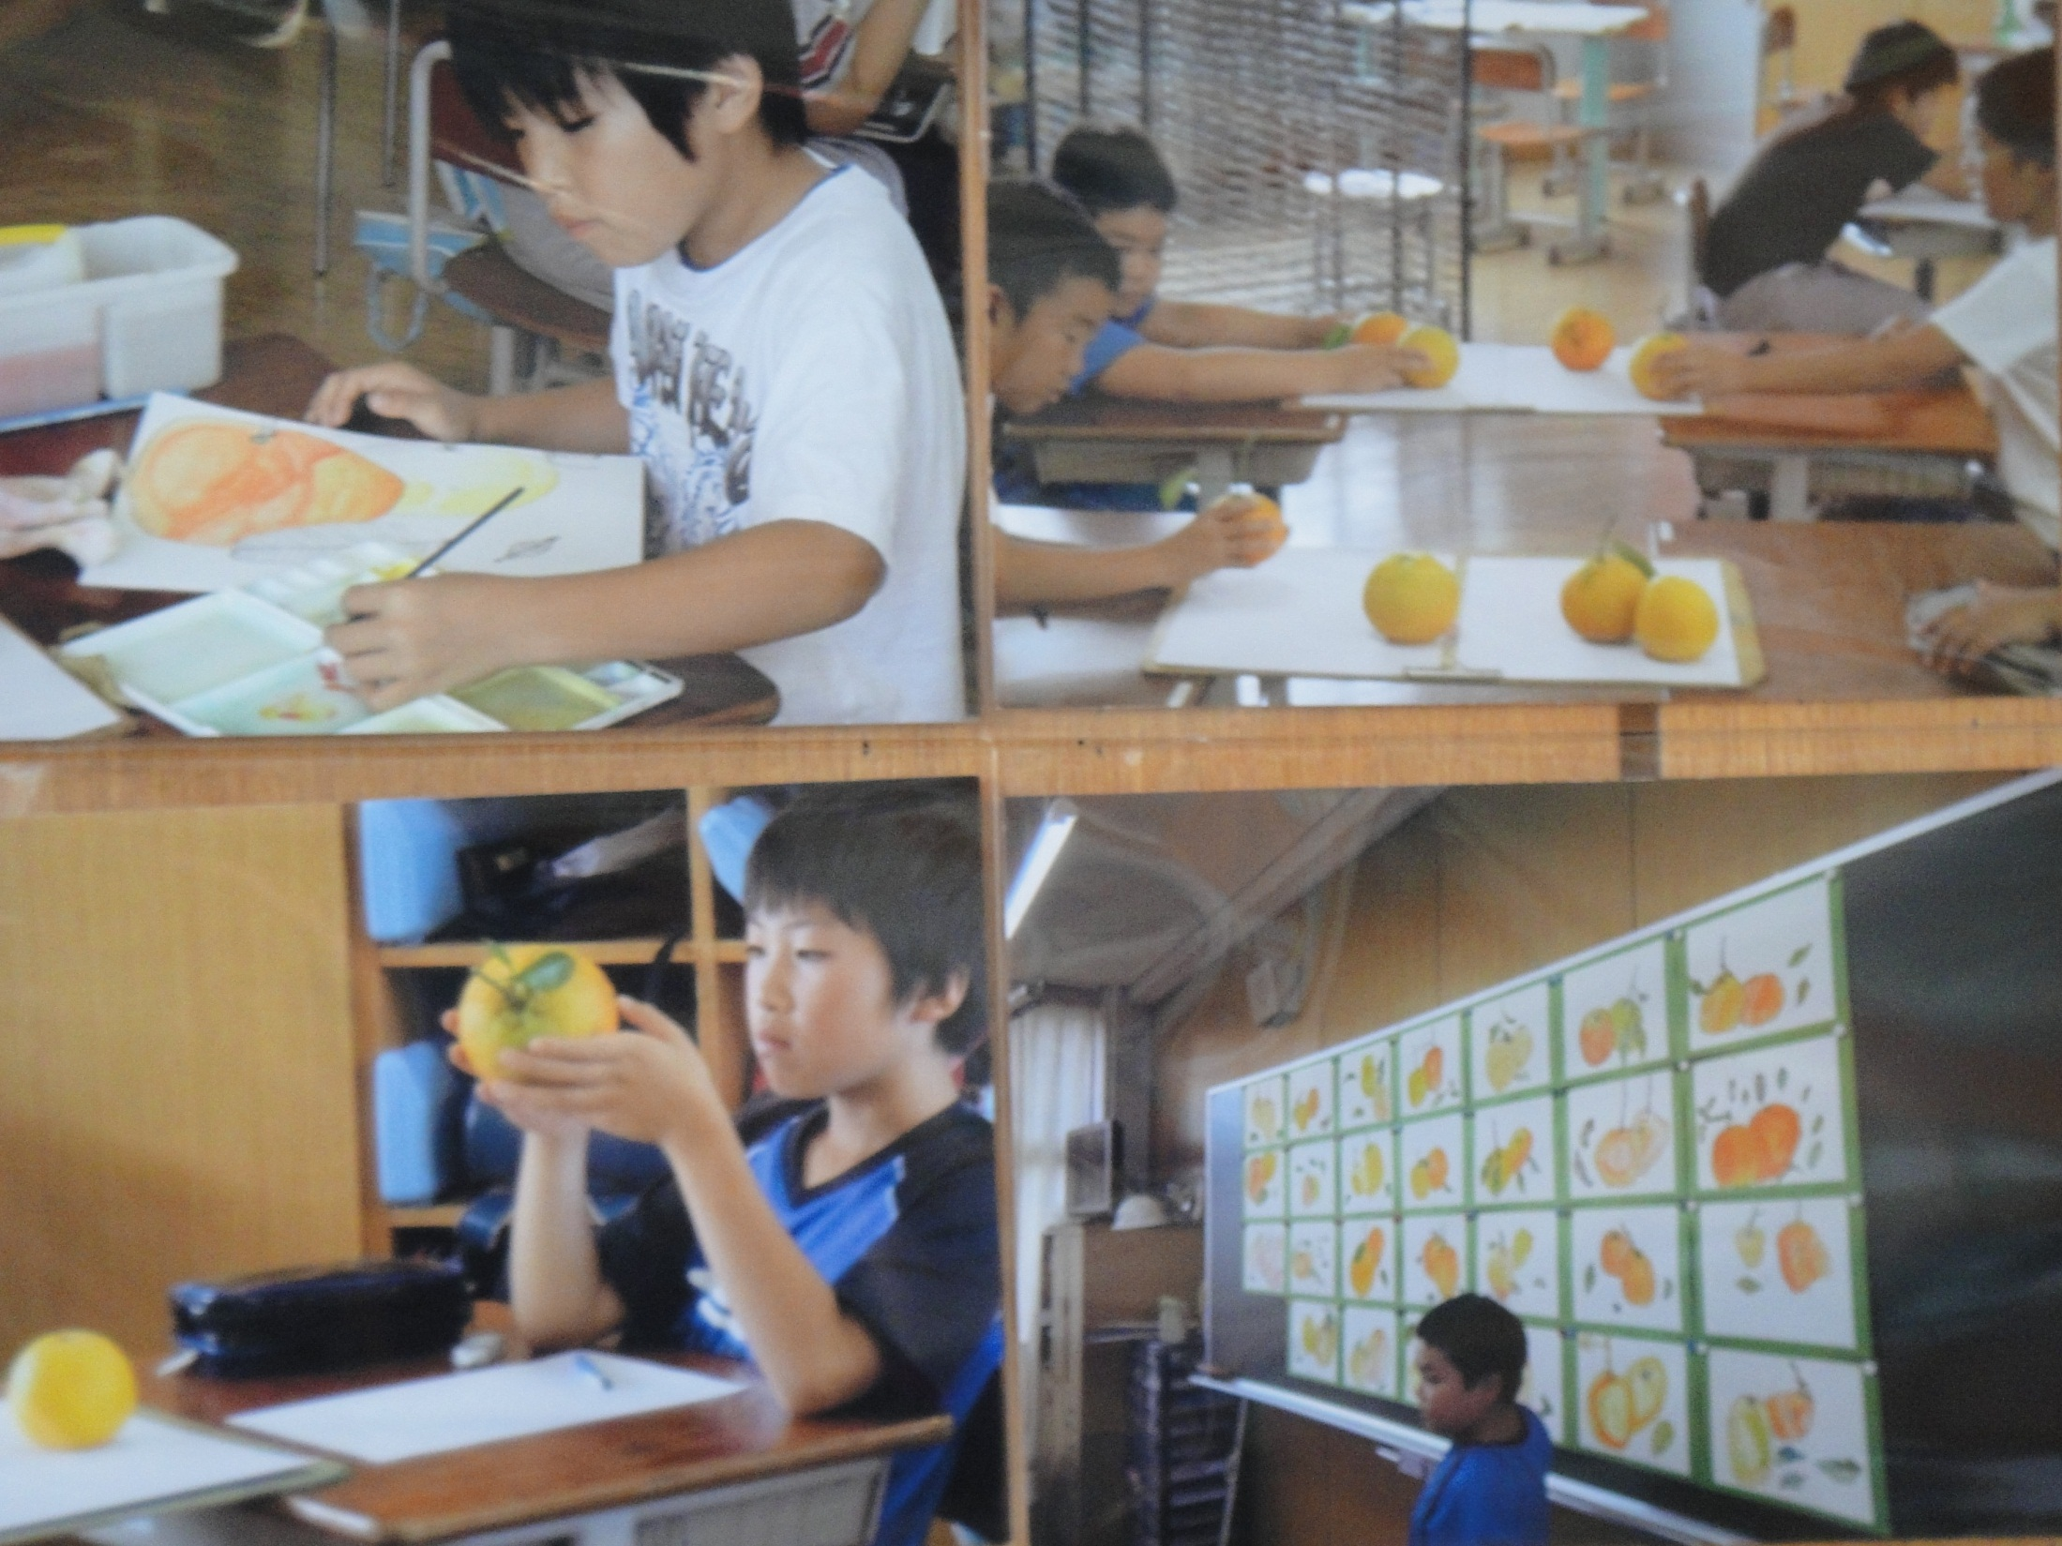

Slide 21
Public Education for ALL (Children and Teachers)
A. Participation in learning
Fostering a sense of belonging
B. Dialogue through listening children’s multi-voices
Forming identity (authorship) in the community
C. Learning through individual differences
Deepening understanding
D. Co-construction through the sharing of knowledge
Fostering a sense of solidarity
E. Reflecting through learning trajectories
Making sense of progress and development

Slide 22
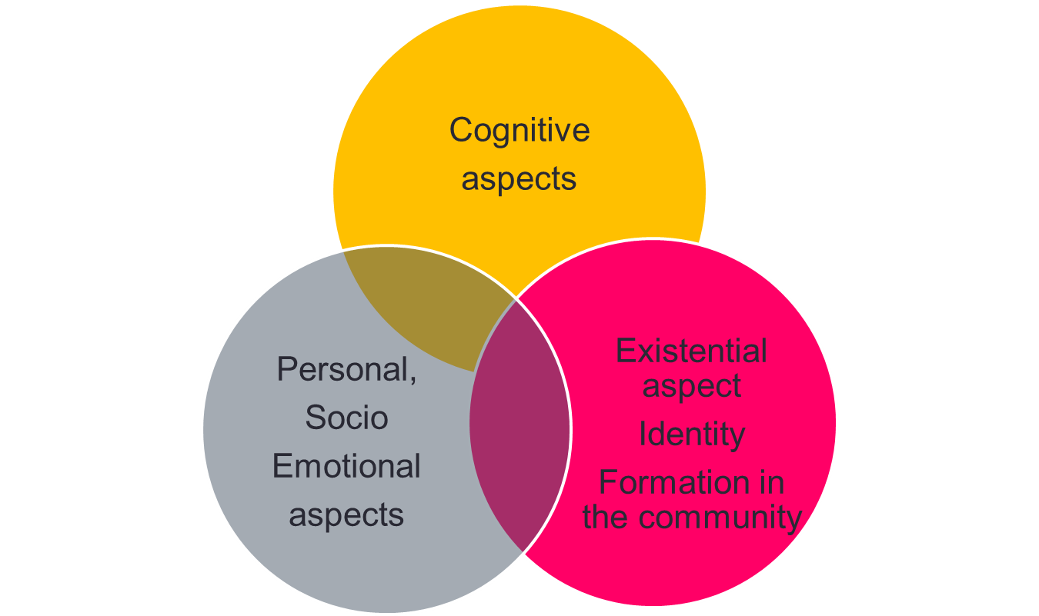
Whole Child (Teacher) Development through Long-Span Perspectives

Slide 23
LS done by Philosophy of Community of Learners
Lesson Study is the main vehicle for the improvement of children’s learning and development, teachers’ professional development, collegiality within the schools, and the democratization of school management, as well as for building a culture of learning （and caring ）communities and connecting local area schools.(Sato,2011)
School
Teacher
Children
Community
Notes:
I aligned the boxes a bit better.

Slide 24
Mr. Kaneko, Senior High School Teacher
His school started LS three years ago
“With the introduction of Lesson Study, teachers changed their views of the students. Observing different subjects’ lessons, I fully realize that I see only limited aspects of students’ competencies. I found my students were concerned that I did not see them in my classes before. I took their concerns seriously, and I changed my teaching style after that.”
“The topics of daily conversation in the staff room changed.”
“The students who generally escapes from learning can come back not only caring, but also building trust and bonding with peers and teachers in a learning process that is mediated by interesting learning materials and challenging task.”
Notes:
I cleaned it up visually.

Slide 25
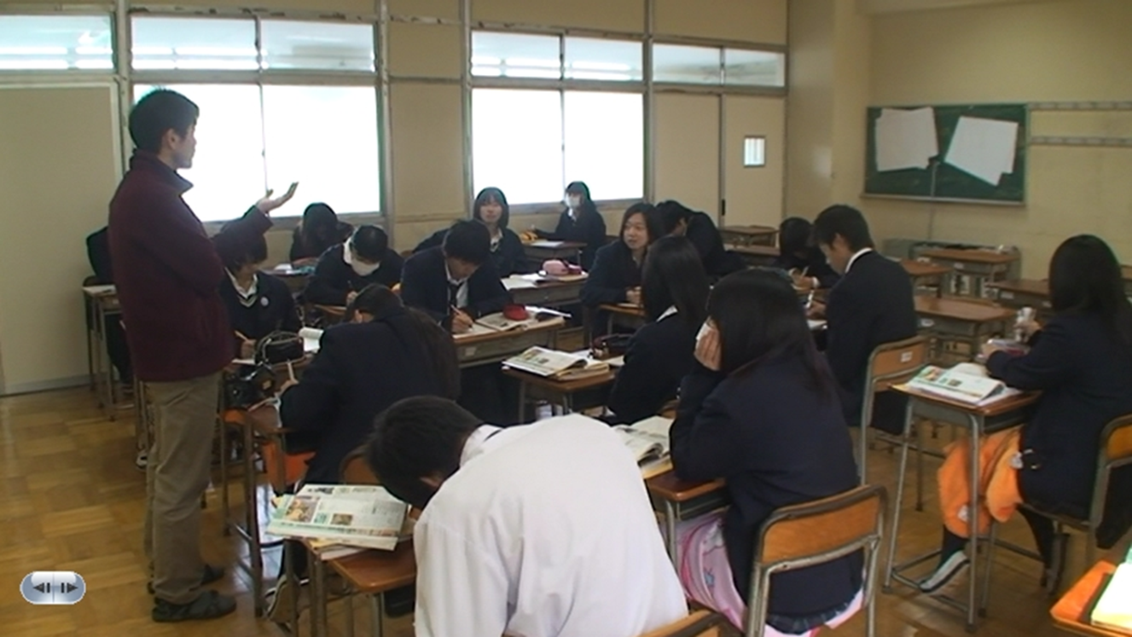
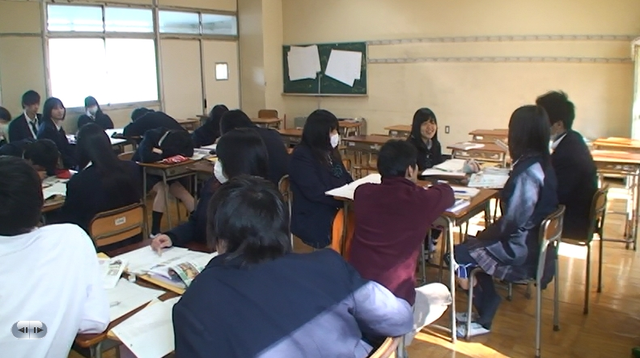

Slide 26
Research Question #2
How can high-quality lesson study be realized?
How do we create and improve upon a school system as a learning and caring community through LS?

Slide 27
Who learns and contributes in LS?
Lesson study is not only for learning opportunities for research lesson teacher, but also for other participant teachers.
How other teachers learn from RL determines the quality of the LS.
An excellent research lesson does not necessarily mean a high-quality lesson study. Terrible lesson sometimes guides for teachers to share difficulties and dilemmas with research teacher and to increase their motivation and engagement for Lesson Study.

Slide 28
Colleagues’ contributions to LS
What to observe in the lesson
How to talk about the lesson
How to listen to other teachers’ talk
How to apply it to my next lesson

Slide 29
2. 1 Carrying Out RL Observation
Improvement of the quality of LS starts with listening to children’s multiple voices during the observation of the lesson and discovering their various relationships.
RL observation creates a vision for the school and offers a concrete image of children’ s learning that is visible in an embodied way.

Slide 30
Understanding the subject matter
Reality
Motivation
Self
Teaching skills
Problem solving
Peers
Child
Teaching
method
Teachers
Activity
Collaborative
learning
Teacher-
initiated
Adult
Text
Materials/
tools
Real objects

Slide 31
The Philosophy of Listening
(Kurahashi, 1936)
Kurahashi thinks that teachers should not only understand what children think, but also listen to their animated voices, like music, and appreciate their hearts and minds as they would the harmony of orchestration.
He emphasized the importance of observing children’s activities in the school setting and of having a caring and tender attitude towards them. The philosophy of recognizing the significance and importance of children’s internal minds, their socio-emotional feelings, interests, and motivations has been derived from Kurahashi’s philosophy.
The philosophy of giving preference to children’s hearts and feelings over their performance in a setting everyday-life has been succeeding since the 1930s.
He said, “Hearts and minds that intend to educate what attempts to educate itself; that is what we can call educating hearts and minds. I do not know any happier hearts and minds than these.”
Notes:
Kurahashi thinks that teachers should not only understand what children think, but also listen to their animated voices, LIKE music, and appreciate their hearts and minds as THEY WOULD THE harmony of orchestration. He emphasized the importance of observing children’s activities in the school setting and OF having a caring and tender ATTITUDE towards them. The philosophy of recognizing the significance and importance of young children’s internal minds, their socio-emotional feelings, interests, and motivations has been derived from Kurahashi’s philosophy. The philosophy of play-centered activities in A SETTING OF everyday-life, and of giving preference to children’s hearts and feelings over their performance, has been SUCCEEDING since the 1930s.
He said, “Hearts and minds that INTEND to educate what attempts to educate ITESELF; that IS what we can call educating hearts and minds. I do not know any HAPPIER hearts and minds THAN THESE.”
I edited the quote because I assumed it was a translation.

Slide 32
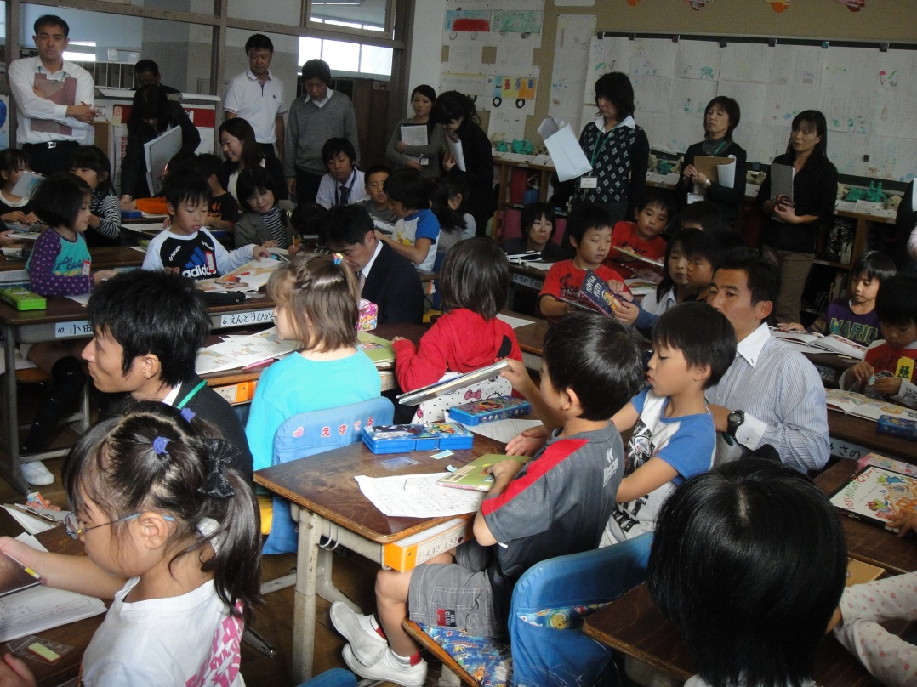
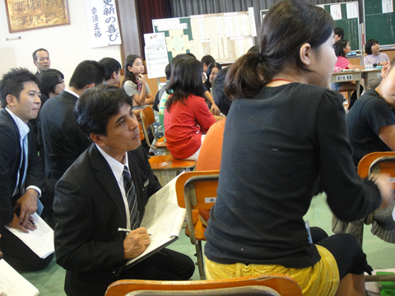
Observing Teachers Listening to Children’s Voices in the RL

Slide 33
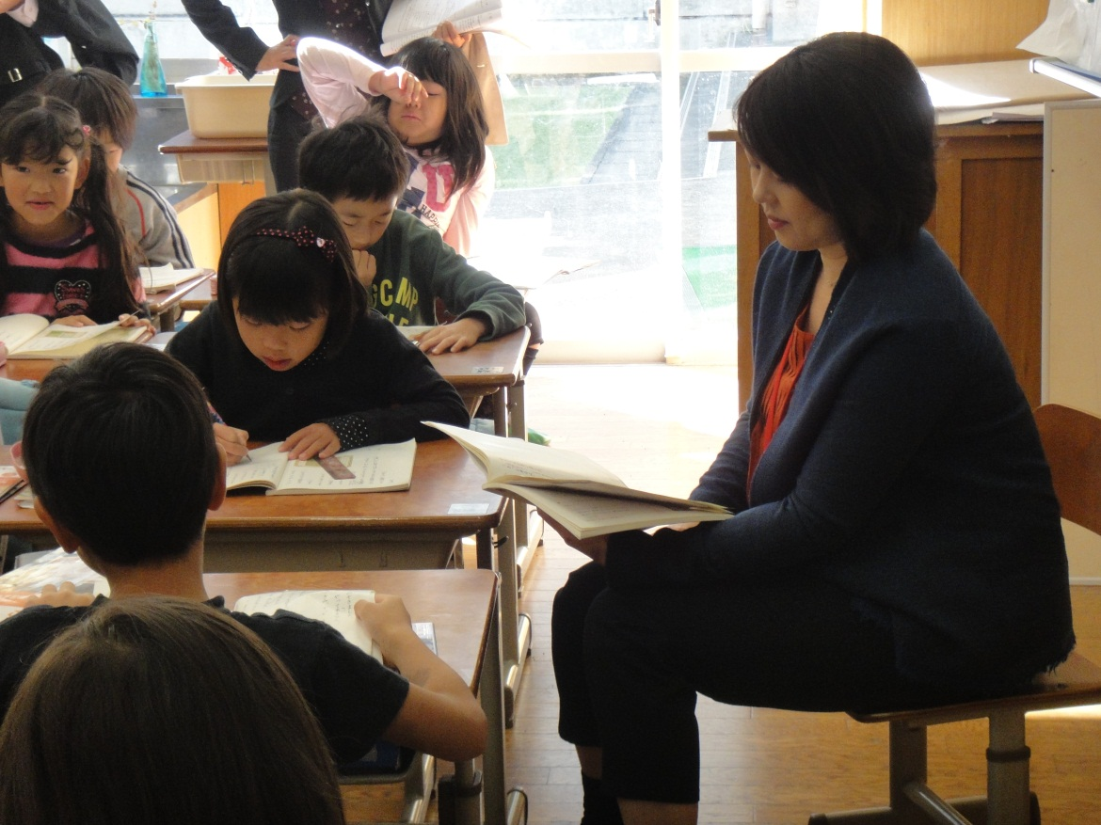
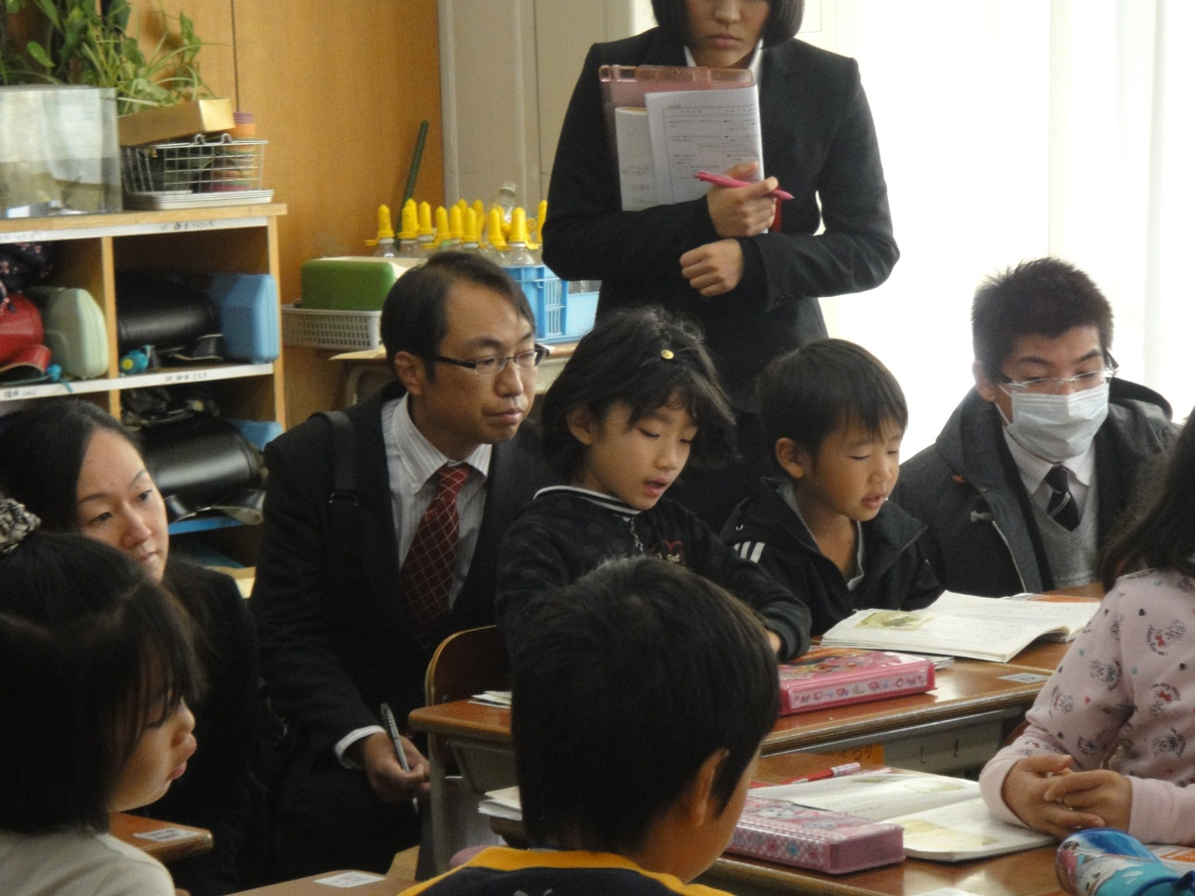

Slide 36
Clues for Listening to Multiple Voices
TASK: Set up a challenging learning task that encourages children to inquire collaboratively, using their prior knowledge and the resources embedded within their learning environment.
Distributed attention: Each teacher is assigned to a group, which he/she observes their learning process intensively. Every teachers take their responsibility to observe children and share their distributed knowledge.
Tools: Recording video-camera, or field-notes
Cues: Using children’s worksheets, create notebooks that can be understood as learning trajectories

Slide 37


Slide 38
2-2 Quality of the Debriefing Discourse
1)Grasping the critical turning point in the flow of lesson, that is, time of change of children’s interests, conception, ideas, interaction among peers and
2) discussing RL teacher’s impromptu judgment and
3) proposing possible alternatives
are related to quality of debriefing discourse.
This sequence (see- think- wonder) is critical.
The classroom is a complex system in which children and teachers face many difficulties and dilemmas.

Slide 39
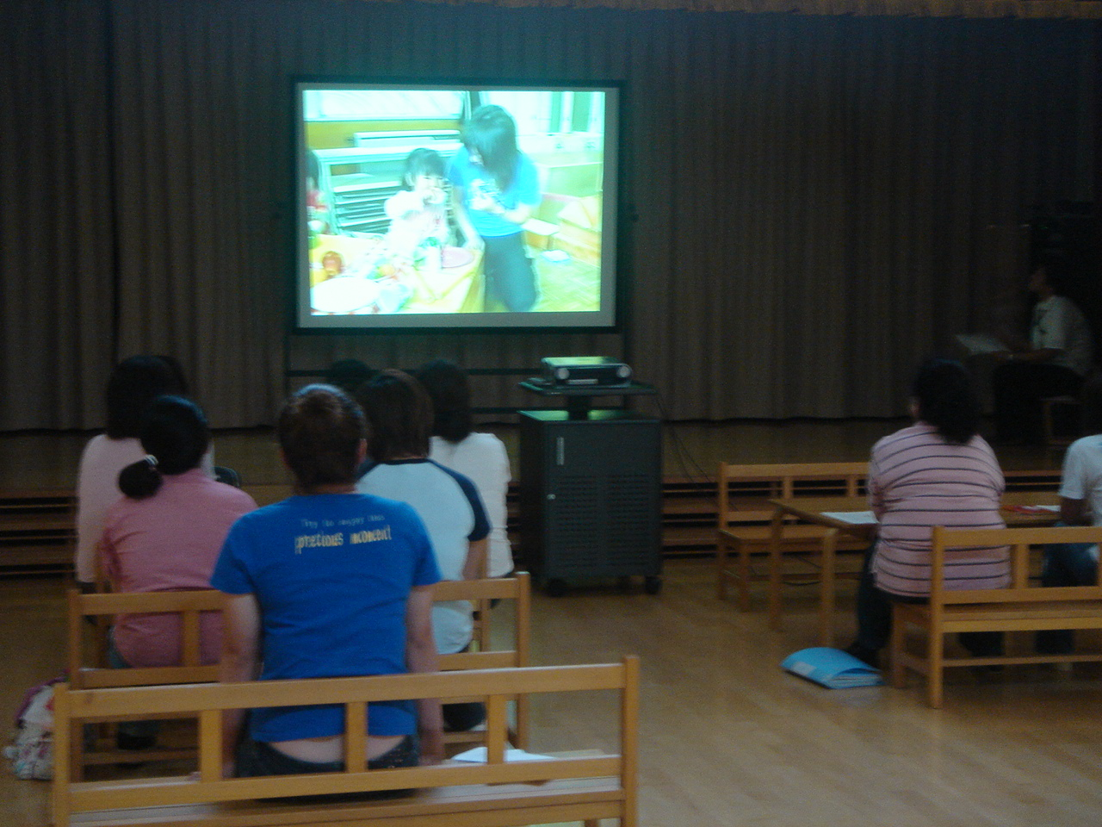
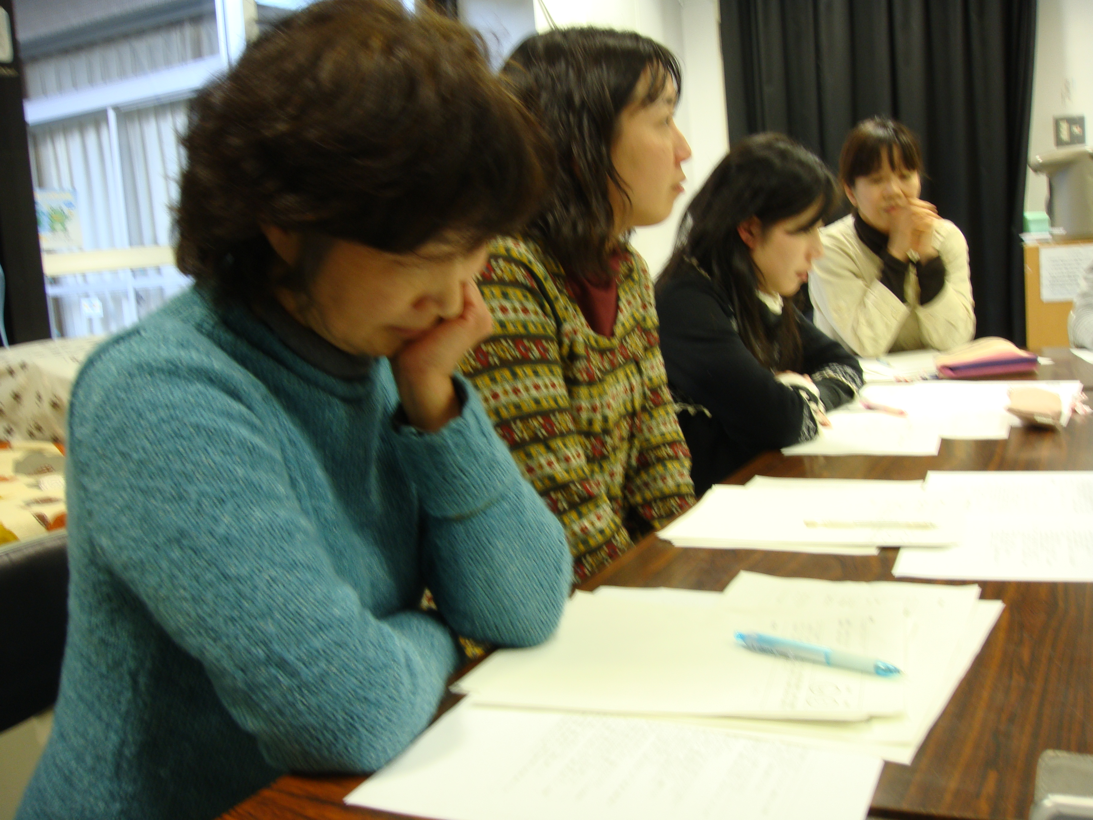
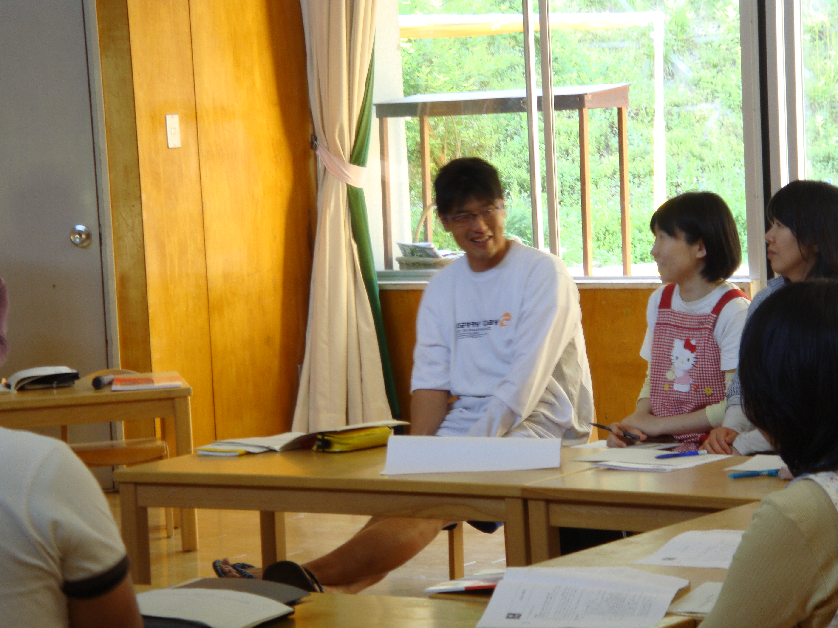
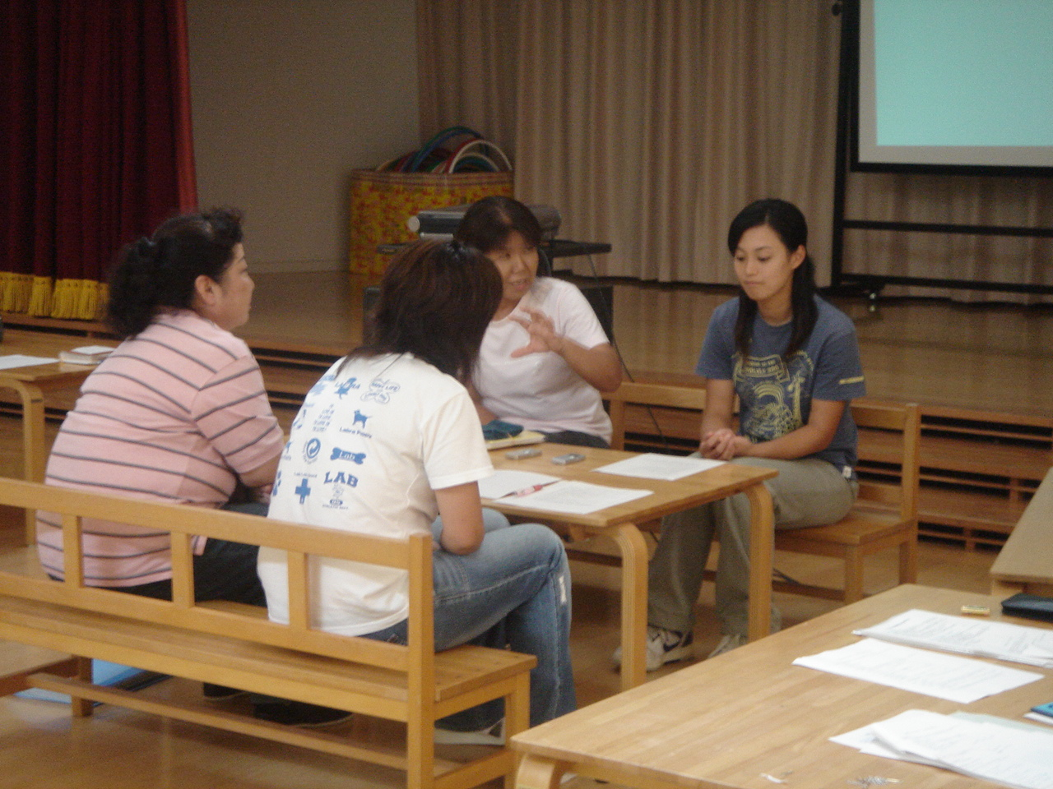
Step 1
Case conferences were carried out in 4 kindergartens using same videos.(Akita, Nakatsubo, Sunagami et els.2012)
B preschool | F preschool | G preschool | H preschool
Discuss Together | Discuss Together | Discuss Together | Discuss Together

Slide 40
Step 2
B preschool | F preschool | G preschool | H preschool
Discuss Together | Discuss Together | Discuss Together | Discuss Together
Teachers discourses were recorded and transcribed in each schools.

Slide 41
Step 3
B preschool | F preschool | G preschool | H preschool
Transcripts | Transcripts | Transcripts | Transcripts
teachers were asked to read 4 transcripts of case conference discourse.

Slide 42
Step 4
B preschool | F preschool | G preschool | H preschool
Transcripts | Transcripts | Transcripts | Transcripts
They were then asked to choose which transcripts they found the most useful for their own professional development and to explain the reason for their choice.

Slide 43
23 categories
Procedure of meeting | 1. Point at issue
 | 2. Not digression
 | 3. Smoothly
 | 4. Animation
Quality of interaction | 5. Reciprocity
 | 6. Sympathy
 | 7. Collaboration
Quality of discussion | 8. Diversity
 | 9. Deepen
Atmosphere & Relation | 10. Guarantee of the hearing
 | 11. Atmosphere
 | 12. Relations to support
Quality of talking | 13. Frankly talk
 | 14. Talking brief
 | 15. Good speech
Subject of conference | 16. Talking based on a video
 | 17. Sympathy to teachers
 | 18. Understanding children
Reflection | 19. Reflect on one’s practice
 | 20. Reflect on one’s school
Design one’s practice | 21. Think about what you would do
 | 22. Make use in one's practice
Improvement | 23. Attitude to learn

Slide 44
Categories | Young Teachers | Experienced Teachers
2. Not digression | 3(3.5) | 0(0.0)
7. Collaboration | 6(7.1) | 2(1.9)
8. Diversity | 11(12.9) | 6(5.8)
9. Deepen | 4(4.7) | 3(2.9)
15. Good speech | 6(7.1) | 4(3.8)
20. Reflect on one’s school | 5(5.9) | 3(2.9)
21. Think about what you would do | 5(5.9) | 3(2.9)
Young Teachers > Experienced Teachers

Slide 45
Case conferences which is important to Young Teachers
A procedure of the conference | Be careful not to digress when I talk | Collaborate between participants based on diverse opinions

Slide 46
Categories | Young Teachers | Experienced Teachers
1. Point at issue | 3(3.5) | 5(4.8)
5. Reciprocity | 5(5.9) | 9(8.6)
6. Sympathy | 4(4.7) | 6(5.8)
10. Guarantee of the hearing | 0(0.0) | 1(1.0)
11. Atmosphere | 3(3.5) | 8(7.7)
12. Relations to support | 2(2.4) | 3(2.9)
13. Frankly talk | 2(2.4) | 8(7.7)
14. Talking brief | 1(1.2) | 5(4.8)
17. Sympathy to teachers | 1(1.2) | 2(1.9)
18. Understanding children | 7(8.2) | 8(7.7)
19. Reflect on one’s practice | 3(3.5) | 9(8.6)
23. Attitude to learn | 0(0.0) | 2(1.9)
Young Teachers < Experienced Teachers

Slide 47
Case conferences which is important to Experienced Teachers
Good atmosphere and interactive opinions | Each participants talk frankly and openly | Talking brief and easy to understand

Slide 48
Two Types of Discourse in the K-level Teachers’ Meeting
(Nakatsubo & Akita 2011, Barnes,1983)
Presentational talk style
Exploratory talk style
Each talk is long, and ideas are organized logically.
The talk is highly coherent;
it is well-organized.
Each teacher emphasizes his or her own ideas.
The behavior of the teachers in the video is examined critically.
Each talk is short and re-voicing is frequently used. The contents of teachers’ talks are complimentary.
Nodding, “ah,” ”uh-huh,” ”well,” pauses.
Emotional disclosure, using emotional words frequently.
The teachers sympathizes with the teacher in the video.

Slide 49
Two Modes of Reflection(Elliot,2007)
Theorizing from the standpoint of action. (Elliot, 2007, 2004)
“Macmury (1957) contrasts
the intellectual mode of reflection with the emotional mode.
In the latter mode, although reflection involves a suspension of action, it adopts the standpoint of the agent” and proceeds “as though we were in action”(p. 212).
“The intellectual mode of reflection seeks a generalizable representation of the events and occurrences it selects for attention. It constructs knowledge scientifically.”
“Emotional reflection constructs knowledge aesthetically.”

Slide 50
(cont.)
“Within the intellectual mode of reflection, theory refers to generalizable representations of the world, while in the emotional mode, it refers to a representation of a possibility for realization in action within a particular situation (p. 212,2007).”
“An emotional mode of systematic reflection, educational action research constitutes an art rather than a science, as it constructs knowledge aesthetically, in unity with the activity of valuation (Elliot, p. 213,2007).”
Notes:
You need a year for your Eliot quote.

Slide 51
Teachers’ work can be understood as emotional care work and academic teaching work at the same time, but how we treat this issue in the lesson study is one key factor for improving its quality.
It is important that participant teachers record facts in the classroom and analyze scientifically critically.
It also important that they feel the sense of agent and valuing the lesson aesthetically

Slide 52
2-3 Role of the Supervisor and Experienced Teacher
There are four processes at work in learning (Shulman, 1996):
  Enactment
  Narration
  Connection (or recounting)
  Abstraction (meta-cognition)
Notes:
I created the list for visual clarity.

Slide 53
Analysis of discourse in briefing session
(Akita.2008)
Twenty-six lesson study meetings over three years in one elementary school and protocols were transcribed (Akita, 2008).
Most of the utterances spoken by the teachers are categorized in the category “Sharing feelings and impressions with others,” “Finding and connecting the episodes in the lesson,” or “Connecting the lesson with other lessons.”
All utterances of category, “Meaning making from broader and high-order perspectives” were utterances spoken by the supervisor and principle.
These abstract conceptions that the supervisor mentions gives teachers a chance to reflect on their teaching, to reframe their beliefs, and to transfer this to their next lesson or to other teachers’ teaching .

Slide 54
RQ2
Listening children’s multiple voices
Intellectual reflection and emotional mode of reflection
sense of agent valuing aesthetically
Meaning making from broader and high-order perspectives or connecting other cases as role of Supervisor, and experienced teacher

Slide 55
Research Question #3
What are the design principles of high-quality lesson studies?

Slide 56
1. Spiral LS Study Cycle
for Professional Development
Research meeting
Writing report
Writing report
Spring seminar
Summer seminar
Open house workshop
Open class
seminar
Redesign
Open class
lesson
LS conference
Redesign
LS conference

Slide 57
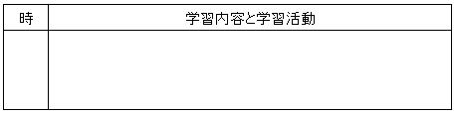
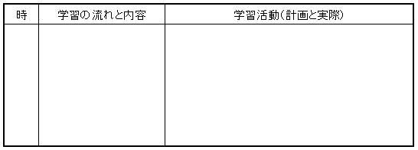
2 .Lesson Study is Connected to Unit Curriculum and Learning Material Development
Long Time Span
物質分類図をつくってみよう 第１学年１月
金属に共通する性質・・・電気を通しやすい
電球の明るさの謎に迫る
電流の流れやすさ
グループでの探究の記録
使い捨てカイロをつくろう 第２学年11月
グループでの探究の記録
Notes:
Don’t forget to translate this slide.

Slide 58
3.Developing Tools and Artifacts for Making School Culture
What to observe in the lesson
How to talk about the lesson
How to listen to other teachers’ talk
How to apply it to my next lesson

Slide 59
4.Human Resources and Cultural Resources Supporting Lesson Study
School
teachers
Local board of education supervisors
University
researchers
Publishers
Teachers’ network beyond schools

Slide 60
RQ#3
The systems that support professional development would be designed to be mutli-layered, multi-links with long time perspectives.
.One characteristic of Japan is that has established multiple links between these elements and resources to maintain a sustainable system.
The learning environment has been rapidly changed with progress of IT and globalization. We Japanese should learn from new style of LS from network members’ countries.

Slide 61
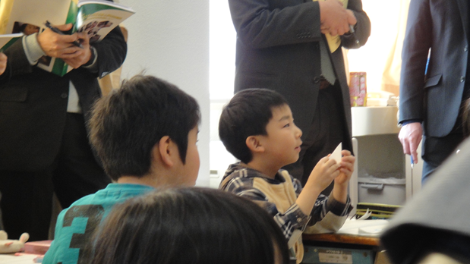
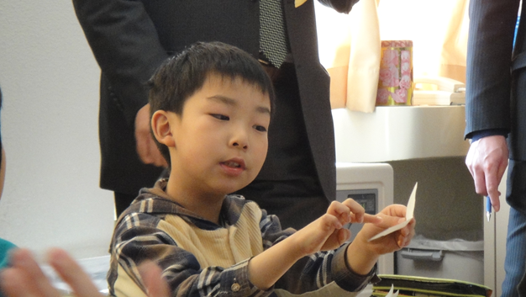
What is high-quality LS?
W. B. Yeats says, “Education is not the filling of a pail, but the lighting of a fire.”
Lesson study is a public space for lighting teachers’ mind and hearts to improve for higher quality of lesson and school .
Teachers are professionals who can develop
by feeling the joy of children’s growth.
Notes:
I made this look cleaner visually.

Slide 62
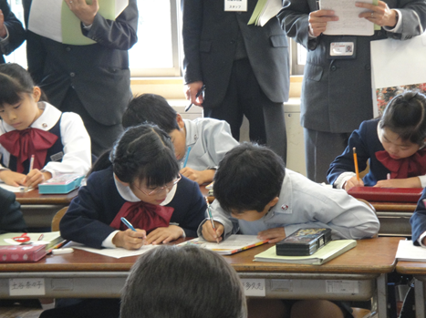
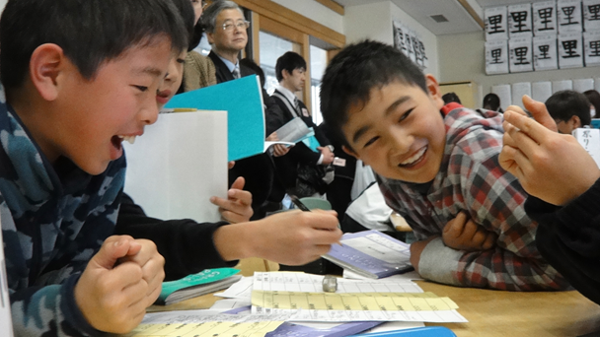
Mr. Ono , principle of Oka elementary school , told teachers after LS.
“You cannot change any others and your work in the past, but you can change yourself and your lessons in the future.”
Lesson study is for the children and teacher’s happiness and future.
Thank you for your attention!

