Slide 1
Diagnosis and Design for Instructional Improvement: Formal Structure & School Work Practice
James P. Spillane
Northwestern University
The Distributed Leadership Studies
http://www.distributedleadership.org
Funded by: National Science Foundation, Spencer Foundation, Institute for Education Sciences, Carnegie Foundation
Notes:
When Chris asked me to come and give one of the opening keynotes, my initial response was but I don’t know anything about Lesson Study …
Having agreed to give this keynote, I spent some time reflecting on what I might have to say, based on my own research and development work, that might be of interest to you and indeed somewhat relevant to your work.
Based on that reflection
I want to argue with you today that Lesson study is a case of something …
I want to argue with you, feel free to argue back at me, that lesson study is a case of something that I label in my own work as an organizational or school system routine. I want to make my case to you today that lesson study is indeed a case of an organization or system routine. Even if you disagree with me, and you should feel free to do that, I hope that what I have to stay will stimulate some new thinking on what I think is very important work.
In making the case that lesson study is a case of an organizational routine intended to enable improvement in instruction, I also want to challenge you … I want to challenge you to reach beyond the work you are doing individually and collective on lesson study and speak more broadly – share your lessons – with scholars like me who do not do research and development work on lesson study BUT who have much to learn from research and development work on lesson study.
Do do so, I want to argue that you will have to grapple with what lesson study is a case of in the broad enterprise we call instructional or school improvement. I offer you one way to do that but I am catholic in my tastes and there are other ways.

Slide 2
Anchoring Instructional Improvement Work
Improving Students’
Opportunities To Learn
Classroom Teaching
What gets taught? How is it taught?
School Practice
Organization & System Infrastructure
Notes:
School Improvement needs to be about instructional improvement …
The bottom line is improving students’ opportunities to learn in school
Depends on classroom teaching – what gets taught/how
That depends in part on teachers’ will and capacity
AND, on the infrastructure that supports classroom instruction and improvement in instruction … local school organization, district infrastructure, etc.

Slide 3
It’s All About Practice
Instructional improvement depends on work practice in schools
Practice is fundamentally social and distributed …
Generated in the interactions among school staff
The situation (social structure) enables and constrains interactions
Situation is both constitutive of, and constituted in, practice
Understanding relations between (Infra)structure and interactions is critical for instructional improvement efforts
A Diagnostic and Design Mindset is essential to instructional improvement
Notes:
Let’s begin with my take home message … what I think is essential if we are serious about fundamentally improving instruction as a means of improving students’ opportunities to learn … So here is my argument …
It is not what people “do” that matters, but how they do so “together” (Becker, 1986).
We love the word context in education … context matters. Well dah … of course it does … without taken for granted things like language, protocols, grade level meetings, Walkthroughs, … The challenge is trying to understand how it matters … HOW it enables and constrains interaction.
Need to go beyond the here and now moment by moment interactions to understand how broader macro social and institutional arrangements are constitutive of and constituted in practice …

Slide 4
Conceptualizing Teaching
Teacher
Students
Materials
(Cohen & Ball, 1998; Delpit, 1996; Hawkins, 1977)
Notes:
5
22
Improving what … conversation about school improvement … instruction just an outcome variable … but also key explanatory variable …
Teaching as what the teacher does … equate teaching with the actions of the individual
Alternatively, we can thinking about teaching as a social practice one that takes form in the interactions among teachers, students and materials …

Slide 5
Overview of Talk
Diagnosis and Design: From a Distributed Perspective
Diagnosis and Design: The Case of Organizational Routines
Designing for Practice: How Infrastructure Matters
Notes:
I acknowledge that you all or some of you may cast lesson study differently (such as a professional development approach as my colleague and friend Catherine Lewis with her coauthors Perry and Hurd put it in a recent article). This is not in opposition to my notion of lesson study as an organization routine …
As Katherine and her colleagues work makes clear …
A Challenge for ‘Lesson Study’

Slide 6
What’s this got to do with Lesson Study?
Lesson study is about (transforming) how teachers practice inside and outside the classroom.
Lesson Study is a case of an organizational (or system) routine.
‘Going to scale’ with lesson study is fundamentally about understanding the dynamics between social (infra)structure and social interactions … the essence of practice.
Notes:
In my humble opinion, lesson study is a case of something bigger … it is a case of an organizational routine
I will end by challenging you to yes continue this exemplary work, talk to one another … and I know many of you share this work … Lesson study and research on lesson study is not some boutique endeavor … it captures the fundamentals of …
Its not what you do, but how you do it that is essential … that a school is doing lesson study is important but what is far more important if change and improvement in teaching and learning is the goal is HOW they are doing lesson study.

Slide 7
Diagnosis and Design from a Distributed Perspective
Notes:
Reflection-in-practice is easier said than done.
An analytical framework is a lens through which we can view a social phe- nomenon such as school leadership and management to focus our atten tion explicitly on certain features of the phenomenon.
We contend that hav- ing an explicit framework is necessary in order to do this work well.
“hero” or “heroine” who is single-handedly responsible for the organiza- tion’s success. These accounts place the leader, such as the school princi- pal, and his or her actions on center stage, reserving a minor, supporting role for others.

Slide 8
“We have one hunter and one gatherer … everyone else is a consultant”
Notes:
Quick fixes are everywhere in the education enterprise. The education bazaar (bizare) is filled with peddlers who sell a variety of wares to schools, peddling everything from programs that address how to teach writing to elementary students to those that show teachers how to use assessment data for diagnostic purposes.

Slide 9
Diagnosis and Design
Diagnosis =
Design =
identify nature or cause of something
shaping things/objects/positions to purposes

Slide 10
A Distributed Perspective
A diagnostic framework that draws attention to particular dimensions of work practice in schools
A design framework for guiding leadership and management improvement efforts.

Slide 11
Practice: From a Distributed Perspective
Leaders
Administrators, Specialists, Teachers
School Work Practice
Situations
Followers
Tools, Routines, Structures
Teachers, Administrators,
Specialists
Notes:
Practice is the central and anchoring concern.
Practice is generated in the interactions of leaders, followers, and their situation; each element is essential.
Practice and practices are not one and the same as practice is emergent … it involves improvisation
Aspects of the situation both define practice and are defined through practice.
Need to attend to the formal and informal organization

Slide 12
Designed vs. Lived Organization
DESIGNED
Formal positions, organizational
routines as represented in formal documents and accounts
LIVED
Organization as experienced in
day-to-day life of organizational members

Slide 13
Diagnosis and Design: The Case of Organizational Routines
Diagnosis and Design Work

Slide 14
Organizational Routines & Practice
Adams School: Breakfast Club, Grade level meetings, Teacher Talk, Teacher Leaders, Five-Week Assessment, Literacy Committee, and Mathematics Committee
Baxter School: Cycle Meetings, Leadership Team Meetings, Literacy Committee, Math/Science Committee
Kosten School: Report Card Review, Grade Book Review, Lesson Plan Review, Faculty Meetings, Grade Level Meetings
Kelly School: Skill Chart Review, Professional Development
Notes:
IN part response to planned change … policy … but more broadly institutional change …
Across all four schools leaders designed organizational routines to standardize their instructional program both vertically and horizontally, working to align classroom practice with the content covered in state and district standards and student assessments.
Of note here is how the naming and form of these routines look somewhat between schools … on closer examination, however, routines with different names were designed to serve relatively similar functions … standardization, accountability, monitoring, and transparency …
Organizational routines embody particular representations of what constitutes good teaching and how to go about the work of instructional improvement …
locally designed meditational means have to be analyzed as part of a wider system that extends beyond the school to the educational sector made up of other schools, district offices, state and federal education agencies as well as an array of extra system agencies
Social interactions are enabled and constrained by various organizational, institutional and cultural artifacts; many of which, we don’t even notice.
the ostensive aspect of routines structure interactions in particular ways enabling

Slide 15
The Case of Organizational Routines
Organizational Routines: “repetitive, recognizable patterns of interdependent actions carried out by multiple actors” (Feldman & Pentland, 2003)
Ostensive Aspect: ideal form – general idea or script of the routine
Performative Aspect: routine in practice in particular places, at particular times
Improving Practice in the interaction of the ostensive and performative aspect of organizational routines.
Concerns about the organizational routine construct – rigid, mundane, mindless, explicitly stored (Cohen, 2007)
Notes:
Organizational routines, staples in all organizations, serve various functions including enabling efficient coordinated action, reducing conflict about how to do organizational work, and storing organizational experiences (Levitt & March, 1988; March, 1991; Argote, 1999)
Some stress their role in preserving the status), others show how routines can be mechanisms for change (Feldman & Pentland, 2003; Sherer & Spillane, 2010).
Limitations –rigidity, mundane, explicitly stored (recipe for routines stored somewhere). “In contrast, when action is taken as central and grounded in habit, the organism, or organization, is much more an historical being.” may privilege formal organization
Strengths – patterned behavior, draw attention to both change and constancy in organizations

Slide 16
Organizational Routines
Advantages
Allow efficient coordinated action
Provide source of stability
Reduce conflict about how to do work
Disadvantages
Result in inappropriate responses
Inertia, mindlessness, and de-motivation
Notes:
Taken for granted staples in every day life in any organization or system for that matter

Slide 17
Organizational Routines at Adams School
Routine | Functions | Tools | People
Five Week Assessment | Formative evaluation Teacher Accountability Monitor Instruction Teacher Development | Standardized Tests Standards Student Assessments | Language Arts Coordinator Assistant Principal Principal Teachers
Breakfast Club | Teacher Development Build Professional Community | Research Articles | Teachers Language Arts Coordinator Principal
School Improvement Planning (SIP) | Identify Instructional Priorities & Resources | Previous Year SIP District Guidelines Test Score Data | Principal Administration Teachers (approved LSC)
Classroom Observations | Teacher Development Monitor Instruction Accountability | School Protocol, District Protocol | Principal Assistant Principal
Real Men Read | Student Motivation and Support | Books | Language Arts Co-ord. Assistant Principal Principal Community Members
Notes:
This is what I mean by the formal structure … what we might think about as an infrastructure for instruction and classroom improvement …

Slide 18
Five Week Assessment: Ostensive Aspect
Step 1. Literacy Committee Identifies Needs & New Directions
Step 2. Literacy Coordinator Plans Five Week Assessment Schedule
Step 8. Literacy Coordinator Shares Scores with Administrators and Teachers & Plan Future Assessments
Step 3. Literacy Coordinator Develops Assessments
Step 7. Literacy Coordinator and Assistant Compile and Analyze Scores
Step 4. Literacy Coordinator and Assistant Copy and Distribute Assessments to Teachers
Step 6. Literacy Coordinator and Assistant Score Assessments
Step 5. Teachers Administer & Return Assessments to Literacy Coordinator
Notes:
Building infrastructures to support practice …

Slide 19
The Five Week Assessment
“We were just kind of casually saying that for the majority of teachers they all work very hard, but some of them get very low results when it comes to these achievement tests … So this [Five Week Assessment] was a way to find out ‘Are they learning?’”
(Literacy coordinator, 10/23/00)
“The [standardized] tests … didn’t give us much information about what we could do to improve our scores because we received the results well after we could do anything about it. We thought that a more frequent assessment … would tell us where the children were”
(Literacy coordinator, 5/15/00)
“The Five Week Assessment enabled teachers to see assessment as a tool for letting them know what they need to work on in the classroom. That was the goal.”
(Principal Williams)
Notes:
A closer look at one routine at Adams, School leaders used the results of the Five Week Assessment to target intervention strategies/ monitor progress on the school’s goals for instructional improvement, and focus professional development. In addition, the routine made some dimensions of teaching practice more transparent as student performance was regularly measured for every teacher in Grades 1 to 8. Based on an analysis the ITBS, school leaders and a group of teachers created benchmarks for student achievement and developed tests to assess student performance on them.
As part of this routine, students in Grades 1 to 8 were tested every five weeks on mathematics, reading, and writing.

Slide 21
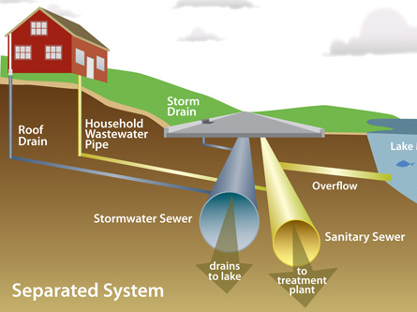
System and Organizational Infrastructure

Slide 23
Designing for Practice: How Infrastructure Matters
Notes:
Extrapolate a number of things/directions for R&D on school leadership and management from this work that have focused our work over the past several years and that I want to focus in on now.
that gets beyond an exclusive focus on the school principal to consider others who take responsibility ….
get beyond notions of practice as individual action to thinking about interactions and how the expertise may be in between …
broaden beyond interactions to develop a better understanding of how formal structure is not only a product of administrative practice BUT fundamentally shapes/defines that practice.

Slide 25
Changing Infrastructure, Changing Interactions
“Everybody did absolutely their own thing as far as literacy. Some people used the Basal series . . . we had different Basal series going in the building. A lot of people were going to a literature-based instruction. Nobody ever talked to each other. It was just—everybody went into their own room, closed the door and did their own thing. So we’ve tried to develop some common vocabulary and common ways of doing things.”
“You close your door. You do what you want. You don’t know what everybody else is doing and it’s fine. Nobody is interested. Nobody’s checking on you or even interested in what you are doing . . . but it changed since then. We work much closer together and I was a very quiet person. . . . Until I was probably elected to . . . chair cycle. First of all, we probably were forced to do some exchange of ideas in—when it first started. Then people found it’s very helpful and nobody keeping anything as a secret so we share freely. And it helps.”
Teacher Interview
Notes:
Our analysis of the performative aspect of organizational routines (a part of the formal structure) shows that, rather than buffering instruction from external regulation, these routines in practice promoted coupling of govern- ment regulation and classroom teaching. These routines promoted coupling because school leaders used state and district regulation as templates and ru- brics in performing key technical efficiency functions including standardiz- ing the instructional program, setting and maintaining direction, identifying and addressing needs including professional development, and monitoring instruction.

Slide 26
Organizational Routines: Performative Aspect
Ms. Sally then switched the topic of discussion to a uniformed spelling program for the grade. She raised the point that it was important for the grade "to be following a sequence for instruction for phonics." Ms. Jill also wants to bring in one of her own favorite books into the curriculum which she claims has a "consistent format which is the most important because the students are missing a range of words. … Ms. Dalia then raised the point that she would be concerned that the grade would not be following the standards of the Illinois State in reference to the [Jill’s] book. [Grade Level Meeting at Baxter, 10/28/99]
Ms. Jones [mathematics teacher leader] remarks, “I don’t too much worry about this one [kind of] question. But now if it’s four or five questions [about the same content on the state test] I target in on that and I make sure my kids know that…” [Annual Kick-off Faculty Meeting at Adams, 8/31/01]

Slide 27
Organizational Routines at Local Proxies for Policy: The Five Week Assessment
First I would like to say congratulations to grade levels—all grade levels made some improvements from the Five Week Assessments to the Ten Week Assessment which is a reflection of your time and commitment to getting students to learn … Third through fifth [grade students need to work on their] abilities to write descriptive words … Probably lacking in vocabulary, ability to pick out details from the story. [Grade Level Meeting]
They [students] did a good job identifying the problem and solution of the story … Which leads me to middle school. Problem and solution didn’t always match … this is truly a concern … Little trouble determining the important information in the story. Questions most missed were vocabulary questions … I have a packet with lessons on teaching vocabulary. I’ll pass it around and if you want me to make you a copy, put your name on the green sticky note [Literacy Committee Meeting, Field Notes, 11/06/00]
Notes:
NOTE here how government standards and tests are invoked INDIRECTLY through local proxies for external policy …
By virtue of participation in the performance of these local organizational routines, school staff members began to standardize content coverage vertically and horizontally,
For example, by participating in the Five Week Assessment the school’s staff monitored their own compliance with government regulations and came to accept instructional transparency, standardization, and monitoring as the way things ought to be. As a result, external enforcement in the form of government incentives and sanctions is not the only thing at play; staff participation in the performance of organizational routines that embody key regulatory ideals also appears to be important. In this way, changes in school norms are forged, at least in part, through trans- forming organizational routines, an aspect of the formal structure, that in turn influences administrative practice. Administrative practice, as jointly enacted by school staff in the performance of organizational routines and structured by the ostensive aspect of the routine, enacts school norms.

Slide 28
Organizational Routines Performative Aspect
 | Adams | Baxter | Kosten | Kelly
Policy | 72% | 67% | 80% | 73%
Technical Core | 100 | 88 | 93 | 82
Technical Core & Policy | 72 | 67 | 73 | 73
Language Arts | 62 | 62 | 24 | 46
Math | 36 | 10 | 17 | 36
Science | 17 | 10 | 7 | 9
Notes:
Some aspect of instruction was addressed in over 80% of the organizational routines ( ranging from 100% at Adams to 82% at Kelly).
Government regulation also featured prominently in the performance of routines (ranging from 67% at Baxter to 80% at Kosten).
Government regulation and instruction figured together in 67% or more of the routines we observed depending on the school …

Slide 30
A Study of Elementary School Mathematics
Study Design
14 elementary schools In Pleasantville, Nebraska.
School Staff surveys administered in Spring 2010, 2011, 2012, (& 2013).
Interviews with purposeful sub-sample in five schools in 2011 and 2012.
Survey Response Rate
2010: 311 staff, 89% response rate, ranging from 82% to 100%.
2011: 337 staff, 95% response rate, ranging from 93% to 100%.
2012: 375 staff , 94% response rate, ranging from 83% to 100%.
Research Question: How do infrastructure redesign efforts shape staff interactions?
?

Slide 31
District Infrastructure Design for Teacher Leadership
Infrastructure for mathematics instruction
Resource and material adoption (Investigations)
State standards alignment
Unit assessment development
Infrastructure (re)design for teacher leadership
District-wide and school specific organizational routines (e.g., arrays, toolbox, PLCs).
Math Coaches in some schools
Professional development for select math teacher leaders
Notes:
My current work is, in many ways, another examination of how infrastructure serves as a mediator between policy and practice. This project focuses on math education, and we are looking at a more local level, the district. States are not only ones making policy, districts are too, in decisions to adopt new curricula or programs for example. In this study we look at one district’s efforts to design and redesign their infrastructure for teacher leadership in mathematics and how the infrastructure shapes school practice, or interactions among school staff, as explored in their advice and information networks.

Slide 32
Social Network Instrument
Screen Shot from SSQ – Math Advice Questions Page 1
Notes:
1999-00
00-01
01-02
02-03

Slide 33
Why Focus on Advice and Information Interactions?
On-the-job interactions associated with the transfer of advice and information – essential to knowledge development:
Socialization: Tacit Knowledge—Tacit Knowledge
Externalization: Tacit Knowledge – Explicit Knowledge
Combination: Explicit Knowledge – Explicit Knowledge
Internalization: Explicit Knowledge – Tacit Knowledge
Blau, 1957; Bryk & Schneider, 2002; Choo, 1998; Coburn, 2001; Daly & Finnigan, 2010; Elmore, 1996; Eraut & Hirsh, 2007; Frank, Zhao, & Borman, 2004; Hill, 2004; Little, 2002; Smylie, 1995; Spillane, 2004
Notes:
How does knowledge get create in schools …
On the job interactions are associated with transfer of advice and information.
Advice and information are fundamental building blocks for knowledge development, a critical ingredient for instructional improvement in schools (Elmore, 1996; Hill, 2004). Shared through interactions….
While formal learning opportunities have taken center stage for policymakers, teachers also develop new knowledge through their interactions with colleagues on-the-job. On-the-job learning happens when organizational members interact, asking questions and getting information, observing colleagues, and giving and receiving feedback (Eraut & Hirsh, 2007; Frank, Zhao, & Borman, 2004; Little, 2002; Smylie, 1995).
While weak ties are sufficient for transferring explicit or simple information (Hanson, 1999), strong ties are necessary for the transfer of tacit, complex, and sensitive information (Reagans & McEvily, 2003; Uzzi, 1997), the sort of information that is key for developing the knowledge that is often critical for improving classroom instruction. Strong ties also support joint problem solving among organizational members (Uzzi, 1997). With respect to tie span, interactions that span "multiple knowledge pools" (Reagans & McEvily, 2003, p. 242) reaching beyond their immediate grade level, or even school, allow school staff to access new information and spark innovation and creativity within the group (Ancona & Caldwell, 1992; Granovetter, 1983; Pelled, Eisenhardt, & Xin, 1999; Tsai, 2001). Without this access to outside information, groups can reinforce undesirable behavior and beliefs (Janis, 1983; Little, 1990). Teachers’ intra- school advice and information networks then are important to the ongoing development of knowledge about instruction inside schools. Still, the available evidence suggests that the more teachers can access related expertise through interactions with colleagues the more they are able to implement instructional change (Reiser et al., 2000; Frank, Zhao and Borman, 2004; Penuel et al., 2007).
3. The formal organizational structure is intended to enable and constrain interactions among organizational members (Blau, 1957; Blau & Scott, 1963).
Aspects of the formal organizational structure such as formally designated positions (e.g., school principal, teacher), organizational sub-units (e.g., grade levels or departments), and formal organizational routines (e.g., faculty meetings, grade level meetings) both enable and constrain interactions among staff.
Schools as organizations seek to cultivate knowledge flow in order to support and coordinate teaching practices. The formal structure assigns people to particular positions and to sub-units that may more or less influence who they connect with, and they require participation in various organizational routines that bring organizational members into contact with some colleagues but not others (Adler & Kwon, 2002; Burt, 1992; Lin and Dumin, 1986; Spillane, Parise, and Sherer, 2011).
In schools, for example, teachers typically work in grade-level or departmental sub-units, and tend to interact more frequently with colleagues in these subunits (Bakkenes, De Brabander, & Imants, 1999; Bryk & Schneider, 2002; Daly, Moolenaar, Bolivar, & Burke, 2010; Rowan, 2002; Penuel, et al., 2009). The formal school organizational structure may support advice and information flow within grades or departments for several reasons, including that teachers teach the same subject or curricular material, prepare students for the same tests, participate in the same organizational routines (e.g., grade level or department meetings), and/or their classrooms are located in close physical proximity to one another. Schools as organizations then contribute to, and constrain, the flow of advice and information by facilitating interaction among particular staff through assignment to sub-units and formal positions (e.g., coach, assistant principal), participation in formal organizational routines, among other things.

Slide 34
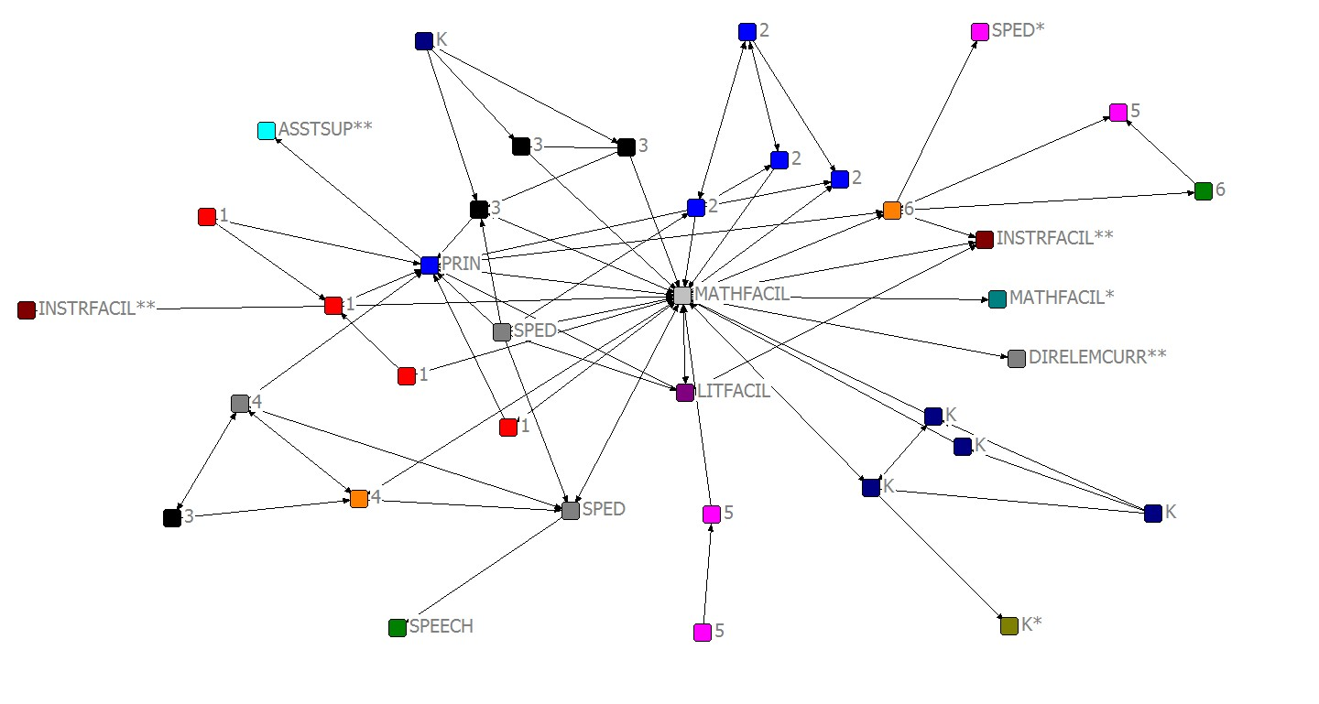
Advice and Information Interactions
A
B
C
Fundamental Math
Math Coach
Fundamental Math
Woodpecker Math Network 2011-2012

Slide 35
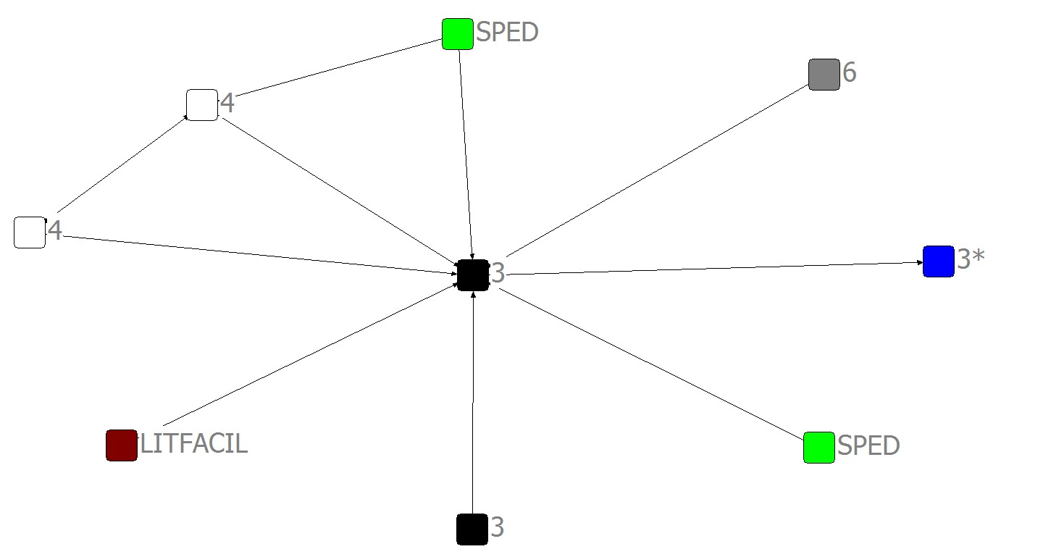
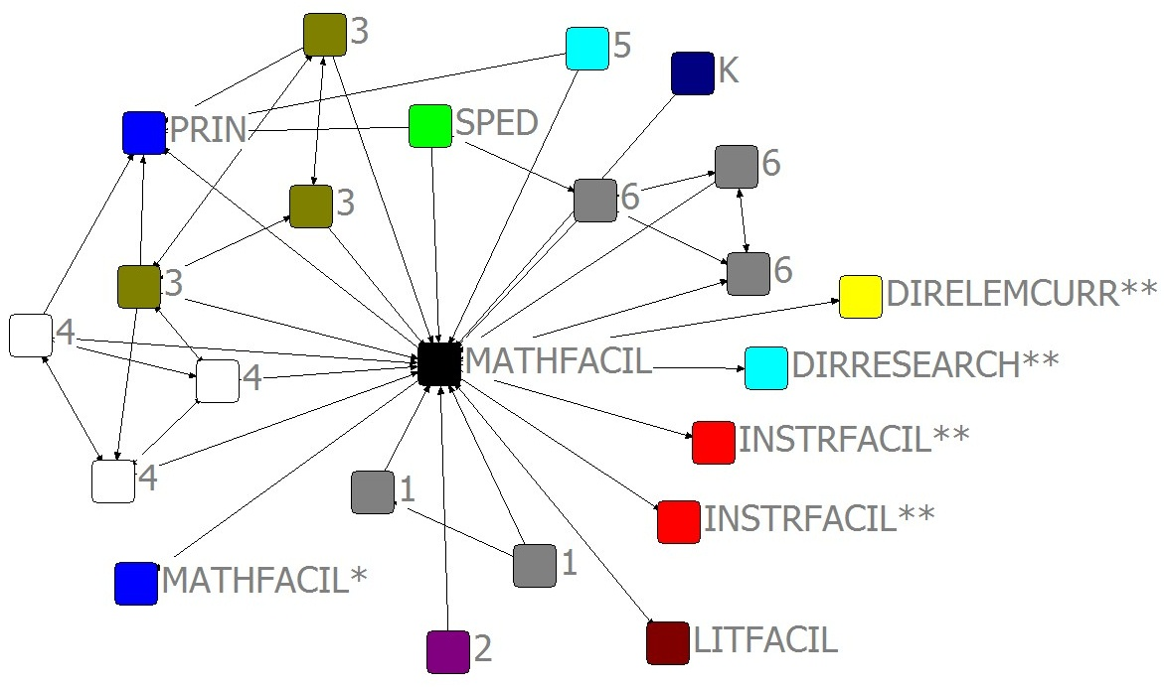
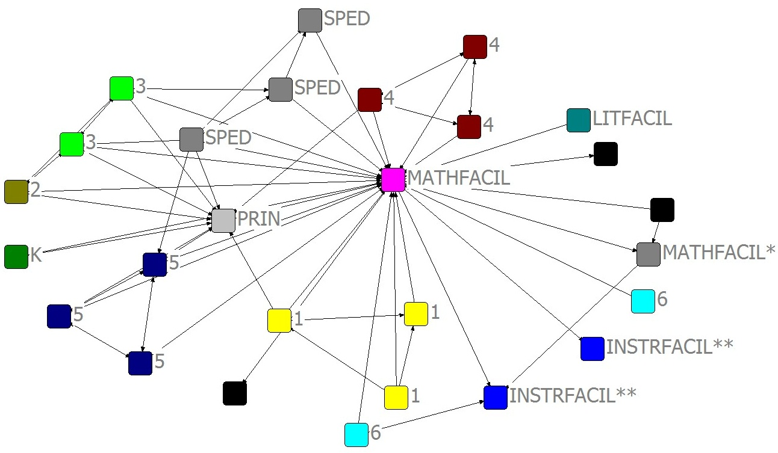
Math Coach (Emily) Facilitates Staff Interactions
2009-10
2010-11
2011-12
Notes:
Math coach in 2010 vs 2011 vs 2012
Higher in-degree and out-degree (explain), reaches more grade levels. In-degree increases from 7 to 16 to 20.
Connections outside of school, to other school and district office
Trends continue in 2012, with more triads forming around coach – so coach is facilitating interactions about math among other staff members. 17 new closed triads in 2010-11 and 15 new closed triads in 2011-12. Triads have been associated with most influence.

Slide 36
Formal Position Promotes Advice Seeking
“[Emily] really wasn’t our facilitator [last year], though she was my co-worker, just a third grade teacher. I knew she had a wealth of knowledge, I just wasn’t in [her classroom] when she was teaching math. But, now that she’s moved into this math facilitator position, that’s different…She’s been trained in it. And, she’s gone to school for it and she’s a great coach. She knows a lot about math and I trust her that she has a lot of, a wealth of knowledge… She’s the go-to person.”
Angie, Special Education
Notes:
So, infusing a school with expertise can develop the infrastructure. Here, a university partner is key to this change. Our future work will explore relationships between the infrastructure, staff interactions, and classroom practice (like my dissertation) and achievement.

Slide 37
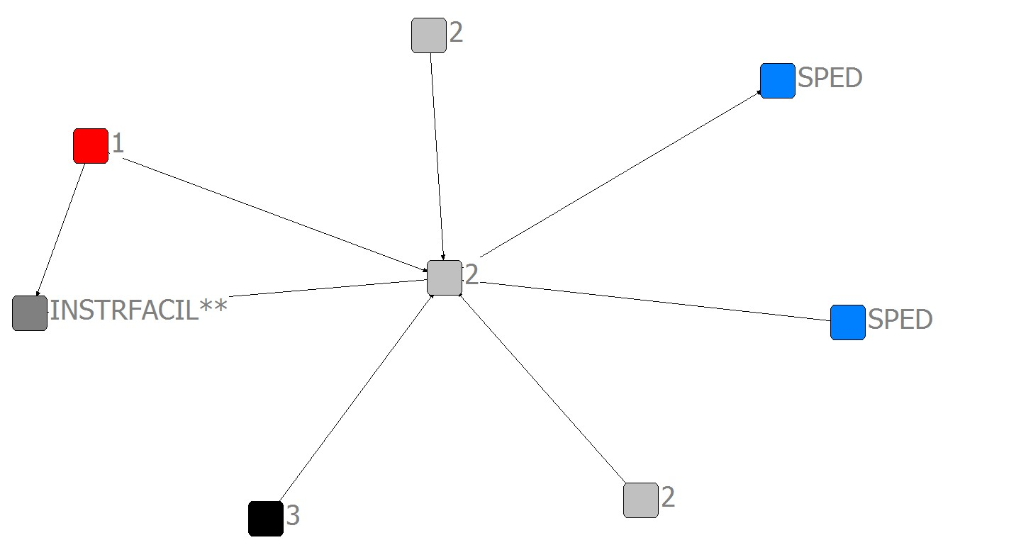
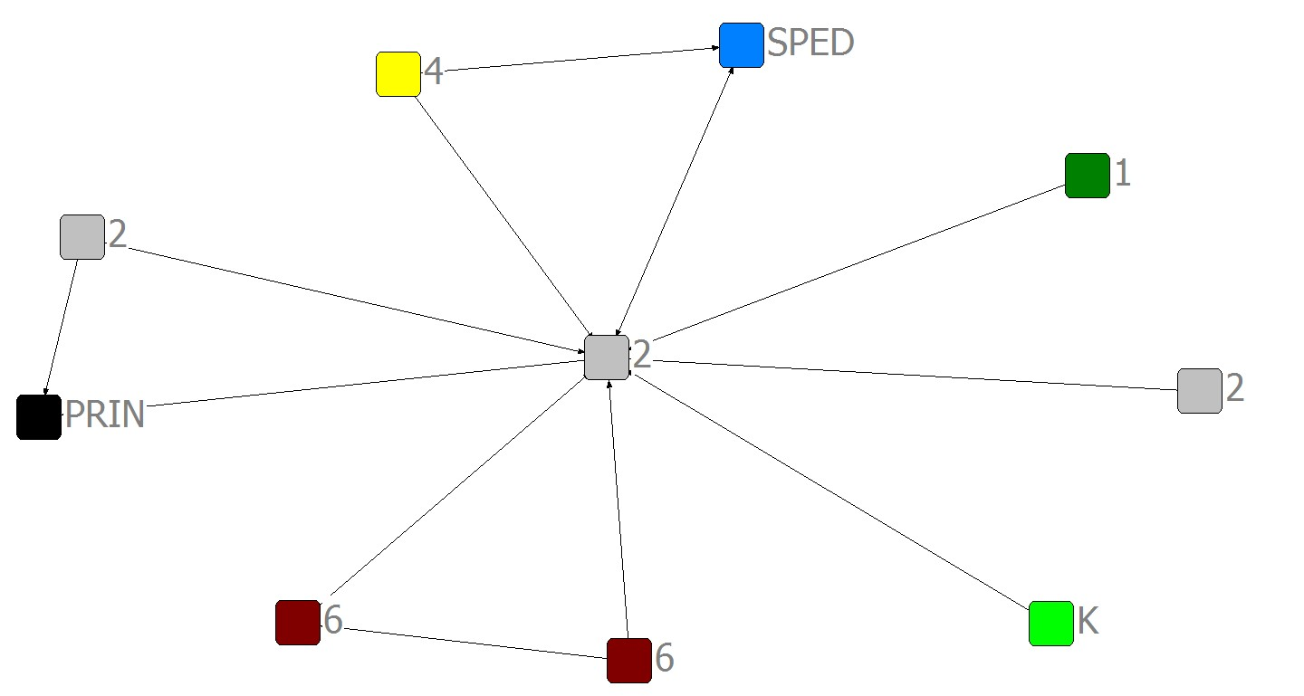
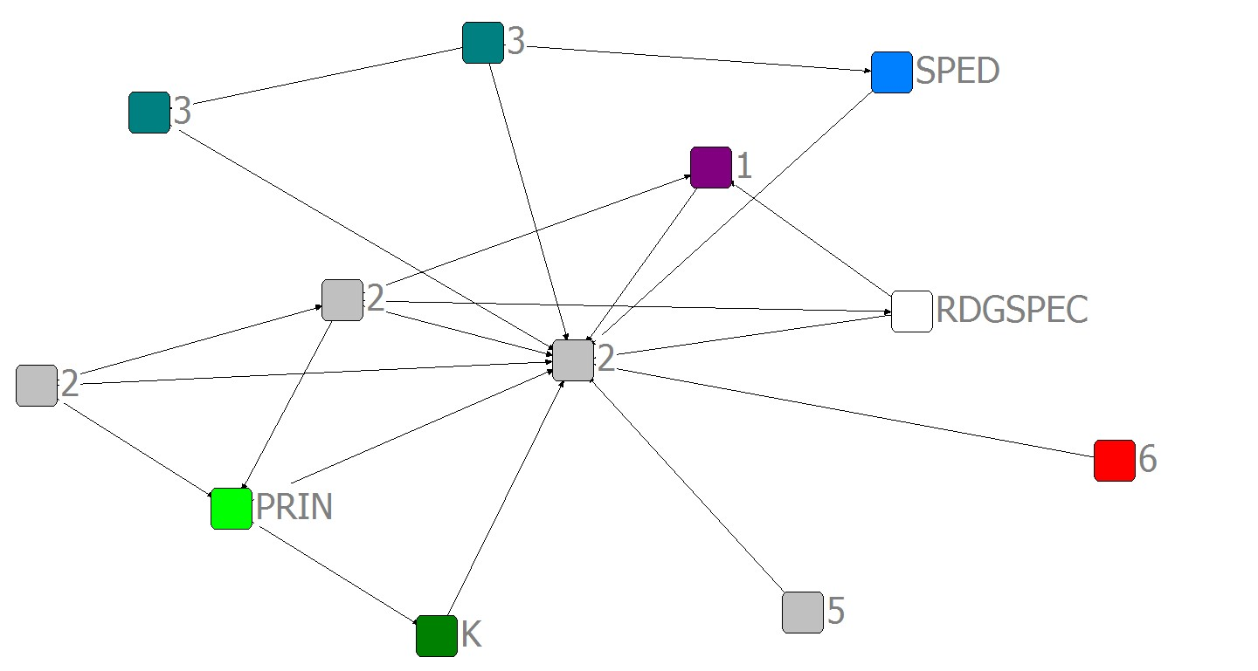
Professional Development Case (John)
2009-10
2010-11
2011-12
Notes:
Math coach in 2010 vs 2011 vs 2012
Higher in-degree and out-degree (explain), reaches more grade levels. In-degree increases from 7 to 16 to 20.
Connections outside of school, to other school and district office
Trends continue in 2012, with more triads forming around coach – so coach is facilitating interactions about math among other staff members. 17 new closed triads in 2010-11 and 15 new closed triads in 2011-12. Triads have been associated with most influence.

Slide 38
Training Also Serves as a Marker of Expertise
“Because he’s a second grade teacher….He’s kind of become the math person to see because he’s taken this extra training that nobody else in the building has done, and I know that he’s interested in math so, he’s just one that I’ve gone to that I know focuses very heavily on, I like his beliefs and the way that he has his room set up and the way that he carries himself.”
Karen (1st grade)
Notes:
Note how selection may also matter …

Slide 39
Infrastructure Redesign Promoted Advice and Information Seeking in Mathematics
Average In-Degree for Teachers Leaders and Other Teachers, Pleasantville School District
 | 2009-10 | 2010-11 | 2011-12
Toolbox Members (6) | 1.60 | 2.80 | 2.67
Fundamental Math Participants (9) | 4.33 | 6.00* | 6.00
Math Coaches (3) | 6.33 | 16.33** | 18.00
Other Teachers (256) | 1.54 | 1.60 | 1.36
*p<.05; **p<.01
Notes:
Fundamental Math participants were sought out by more colleagues for advice and information about mathematics in 2010-11 than in 2009-10. Specifically, eight of the nine participants in Fundamental Math increased their in-degree centrality, ranging from an increase of one to twelve (Mary).
Regular teachers increased indegrees ranged from 0 to just 0.5
These trends hold across schools, not just one. Formal position particularly important, as we will see in next 2 slides. (2012 data shows consistency from prior year, even for coach who no longer holds the formal position.

Slide 40
Infrastructure Redesign Promoted Brokering in Mathematics
Average Betweenness for Teachers Leaders and Other Teachers, Pleasantville School District
 | 2009-10 | 2010-11 | 2011-12
Toolbox Members (6) | 5.00 | 75.80* | 48.86
Fundamental Math Participants (9) | 32.44 | 144.33* | 115.42
Math Coaches (3) | 38.67 | 248.67** | 222.97
Other Teachers (256) | 10.85 | 24.81* | 11.90
*p<.05; **p<.01
Notes:
These trends hold across schools, not just one. Formal position particularly important, as we will see in next 2 slides. (2012 data shows consistency from prior year, even for coach who no longer holds the formal position.

Slide 41
Formal Organizational Structure & Advice & Information Interactions
Teachers more likely to seek advice from others of same gender and race.
Prior tie strongly associated with having a current tie.
Formal leaders more likely to provide advice or information.
Teachers in the same grade were more likely to receive or provide advice or information
Teachers more likely to seek advice about a subject from teachers who reported more PD in that subject.
Spillane, J. P., Kim, C. M., & Frank, K. A. (2012). Instructional advice and information seeking behavior in elementary schools: Exploring tie formation as a building block in social capital development. American Educational Research Journal.
Notes:
We did find evidence of homophily based on personal characteristics. Similarity of race and gender were associated with the emergence of a new advice or information tie among staff. Teachers of the same race were more likely to receive or provide advice or information from one another than those of different races as suggested by a positive dyadic effect of same race (0.45)
Teachers and school leaders were more likely to receive or provide advice or information from a colleague of the same gender as suggested by a positive dyadic effect of same gender (0.41).
Our analysis also suggests that career stage matters with more experienced teachers less likely to receive advice or information about mathematics than their less experienced colleagues as indicated by a negative receiver effect of career stage (-0.25). All three results – race, gender, and career stage – are statistically significant.
BUT, and more interesting, is that formal structure matters to advice and information seeking behavior …
Our analysis suggests that while school leaders’ and teachers’ personal characteristics are associated with teachers’ instructional advice or information flows, the formal organization in the form of grade level assignment, having a formally designated leadership position, and teaching a single grade trumps individual characteristics. Controlling for prior ties, our analysis shows that grade level assignment is strongly associated with the formation of a new tie. We might expect this finding for several reasons.
Our analysis also suggests that there is a relationship between the formal organizational structure and informal advice seeking patterns. VERY NICE LOGIC IN OUR PROGRESSION HERE First, in a study of 30 elementary schools in one district, we found that after controlling for a tie from the previous school year, teachers in the same grade were more likely to receive or provide advice or information as reflected in a positive dyadic effect of same grade taught (3.02). Second, school staff members with formally designated leadershiproles were more likely to provide advice or information as reflected in a positive provider effect of formally designated leaders (1.28). WE ASCRIBE TOO MUCH OF OUR OBSERVATIONS INSIDE OF SCHOOLS TO HEROIC CHANGE AGENTS OR ENTREPRENURS--OR IN THE CASE OF SCHOOLS THE PRINCIPALS AND THEIR ACTIONS--WITHOUT REALLY UNDERSTANDING HOW THE FORMAL STRUCTURE AND ROUTINES OF SCHOOLING OCCASIONS SOME ACTIONS AND EFFECTS OVER OTHERS.
School Principal is less relevant or irrelevant?
Formal Organization is less relevant?
Everyone is a Leader?
The More (Leaders), the Merrier?

Slide 42
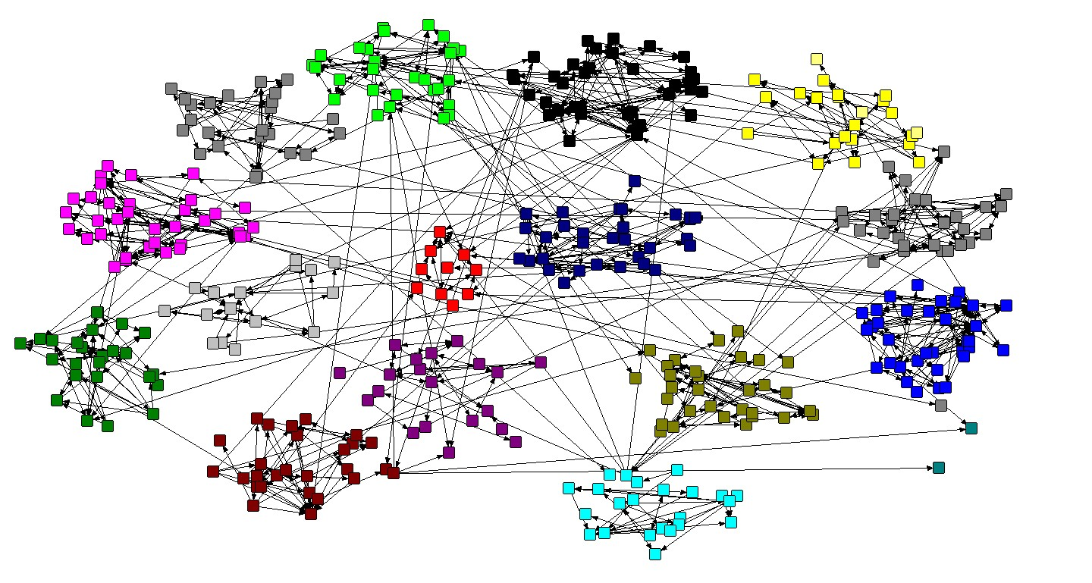
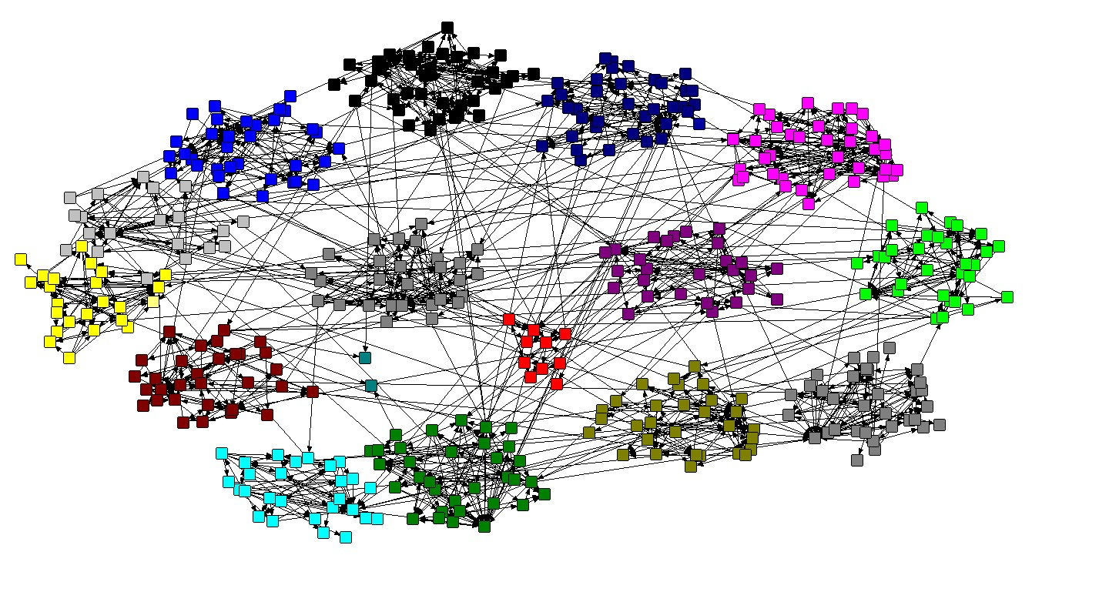
Pleasantville District Math Network
Pleasantville District ELA Network
Notes:
Beginning to look at broader infrastructure and the opportunities and challenges to instructional improvement.
Red dots are central office staff

Slide 43
Infrastructure
Anchoring in and Alignment with Instruction
Cognitive adequacy
Consistency
Communicability, Corruptibility, and Correctability
Authority and Power
Notes:
Cannot design practice – can design for practice …
Lost in translation ….

Slide 44
Notes:
Picking out bits of an infrastructure without attending to the infrastructure of which they are part …

Slide 45
Conclusion
Notes:
My account to this point suggests a number of directions for research on school leadership and management …that I want to focus in on now. First, these are the need for research that gets beyond an exclusive focus on the school principal to consider others who take responsibility for leadership and management inside schools. Second, broaden beyond interactions to develop a better understanding of how formal structure is not only a product of administrative practice BUT fundamentally shapes/defines that practice. Third (MAYBE), get beyond notions of practice as individual action to thinking about interactions and how the expertise may be in between

Slide 46
Lesson Study: Ostensive Aspect?
Teachers design, collaboratively, detailed lesson plan
Teacher teach lesson in a real classroom as other others observe
Teachers together discuss their observations of the lesson and redesign lesson
Another teacher teaches redesigned lesson and group critique
Lesson should be both relevant and useful for teachers when examining their practice.
Notes:
“professional development process” “teachers working collaboratively on a small number of "study lessons” “study lessons involves planning, teaching, observing, and critiquing the lessons” “teachers select an overarching goal and related research question that they want to explore” “teachers jointly draw up a detailed plan for the lesson” “a teacher teach the lesson in a real classroom as other others observe” “group then comes together to discuss their observations of the lesson” “group revises the lesson, and another teacher implements it in a second classroom”
(Read about lesson study “professional development process” “teachers working collaboratively on a small number of "study lessons” “study lessons involves planning, teaching, observing, and critiquing the lessons” “teachers select an overarching goal and related research question that they want to explore” “teachers jointly draw up a detailed plan for the lesson” “a teacher teach the lesson in a real classroom as other others observe” “group then comes together to discuss their observations of the lesson” “group revises the lesson, and another teacher implements it in a second classroom”
“guiding principles behind the process of lesson study” (CHOKSHI AND FERNANDEZ, 200?).
Lesson study is an exotic idea from a foreign country, so it can’t be done in the U.S. (CHOKSHI AND FERNANDEZ, 200?

Slide 47
Asking Design Questions
What is the theory of action behind the routine/tool?
What arguments explain and evaluate the routine/tool?
Why should it work?
Why might it not work?
What are the advantages of this routine?
What are the disadvantages of this routine?
How does it connect with classroom teaching and learning?

Slide 48
‘Kernel’ Organizational Routines
Propagate and seed new forms of school practice
Key characteristics:
focused on teaching and student learning
anchored in both intended curriculum and enacted curriculum
build common understanding among school staff
build trust among school staff
enable mutual access to information among staff
build routes for new information to enter the school
facilitate tailoring of the routine by school staff to local circumstances
(Resnick, L. B., Spillane, J. P., Goldman, P., & Rangel, E., 2010)

Slide 49
Conclusion
School and system infrastructure design and redesign essential to improving work practice in schools.
The essence of instructional change:
Understanding relations between infrastructure and everyday interactions.
Understanding how components of infrastructure travel and often get lost in translation.
Adopt a Diagnosis and Design Mindset
Notes:
1) How does recoupling happen on the ground … role of school administration – formal structure and administrative practice. I want to offer vivid looks at how policy looks inside schools …
2) Based on this analysis, I argue that we need to broaden how we think about
A) research work on school administration in SEVERAL WAYS…
a. beyond the school principal by considering administrative practice and who co-performs that practice …
b. beyond notions of practice as individual action to thinking about interactions and how the expertise may be in between … stretched over two or more people
c. broaden beyond interactions to consider the role of the formal structure in administrative practice …
B) Development work on school administration …
I will use examples from my own research to illuminate these points …

Slide 50
Publications and Presentations available online: www.distributedleadership.org
Spillane, J. P., Parise, L. M., & Sherer, J. Z. (2011). Organizational routines as coupling mechanisms: policy, school administration, and the technical core. American Educational Research Journal, 48(3), 586-620.
Spillane, J. P., & Anderson, L. M. (under review). Policy, practice, and professionalism: Negotiating policy meanings in practice in a shifting institutional environment. Educational Evaluation & Policy Analysis.
Sherer, J. Z., & Spillane, J. P. (2010). Constancy and change in school work practice: Exploring the role of organizational routines. Teachers College Record, 113(3).
Spillane, J. P., Kim, C. M., & Frank, K. A. (2012). Instructional advice and information seeking behavior in elementary schools: Exploring tie formation as a building block in social capital development. American Educational Research Journal, 49(6), 1112-1145.
Spillane, J. P., & Healey, K. (2010). Conceptualizing school leadership and management from a distributed perspective. The Elementary School Journal, 111(2).
Spillane, J. P., Healey, K., & Kim, C. M. (2010). Leading and managing instruction: Using social network analysis to explore formal and informal aspects of the elementary school organization. In A. J. Daly (Ed.), Social network theory and educational change (pp. 129-156). Cambridge, MA: Harvard Education Press.

Slide 51
MORE AT:
http://www.distributedleadership.org

